Slide 2
Semantic Types
Permissive Type
VB default
Implicit narrowing casts
Strict Type – Use for all projects in this class.
Explicit narrowing casts
Eliminates surprises
Use for all code in this class

Slide 4
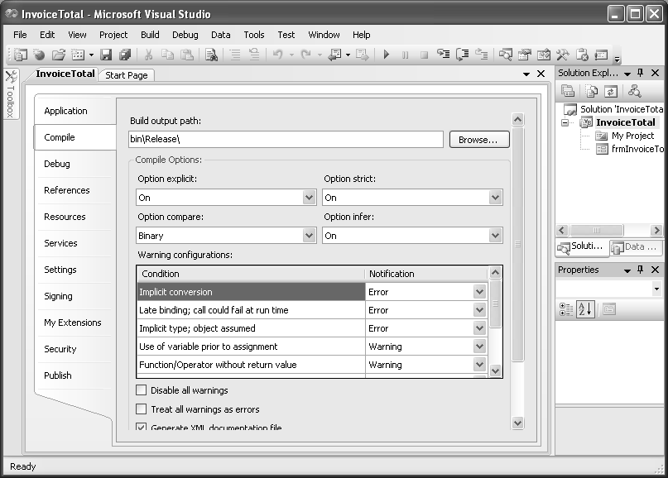

Slide 6
Change semantic type for all new projects

Slide 7
Option Strict
Use for all projects in this class.
Use literal type characters to force type.
Example – 459.65D
Example – “a” C

Slide 8
Option Explicit
Forces the declaration of all variables
Steps to set On/Off similar to option Strict
Must be on for all projects in this class

Slide 9
Shared methods of the Math class
Called from the MATH class
Syntax – Math.MethodName(argument₁, [argument₂]…)

Slide 11
Round Method
Can be used with Double or Decimal values (or any number that can be converted to one of these)
Uses Banker’s Rounding
Midway between whole numbers rounds to the even number.
Examples
Math.Round (13.5) → 14
Math.Round (12.5) → 12
Math.Round(13.3) → 13
Math.Round(13.645, 2) → 13.64

Slide 12
Sqrt, Min, & Max
Shared methods of the Math class
Can be used with any numeric data type
Max & Min
Require two values
Two values must have the same data type

Slide 37
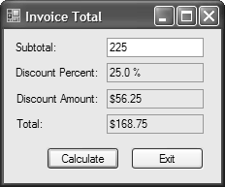

Slide 41
