Slide 1
How to Work with Numeric and String Data
Murach, Chapter 4

Slide 2
Two Data Types
Value Types – Store their own data
Reference Types
Do not store their own data
Stores a reference to an area of memory

Slide 3
The Built-in Integer Value Types
Keyword Bytes Type Description
Byte 1 Byte Positive integer value from 0 to
255
SByte 1 SByte Signed integer value from -128
to 127
Short 2 Int16 Integer from –32,768 to +32,767
UShort 2 UInt16 Unsigned integer from 0 to
65,535

Slide 5
The Built-in Integer Value Types
Keyword Bytes Type Description
Integer 4 Int32 Integer from –2,147,483,648
to +2,147,483,647
UInteger 4 UInt32 Unsigned integer from 0 to
4,294,967,295
Long 8 Int64 Integer from –9,223,372,036,854,775,808 to +9,223,372,036,854,775,807
ULong 8 UInt64 An unsigned integer from
0 to +18,446,744,073,709,551,615

Slide 6
The Built-in Non-Integer Number Value Types
Keyword Bytes Type Description
Single 4 Single Approximately 7 significant digits
Double 8 Double Approximately 14 significant digits
Decimal 16 Decimal Up to 28 significant digits (integer and fraction) that can represent values up to 79,228 x 10²⁴

Slide 7
The Built-in Non-Number Value Types
Keyword Bytes Type Description
Char 2 Char A single Unicode
character
Boolean 1 Boolean A True or False
value

Slide 8
Defaults for Value Types
Number : 0
Char: Binary 0
Boolean: False

Slide 9
Declare a Variable: No AS Clause?
Dim price = 14.95
Dim price As Double = 14.95
Dim price As Decimal = 14.95
Difference in the above three?
When to use decimal?

Slide 10
Declare a Variable: No AS Clause?
Dim numberOfTests = 8
Dim numberOfTests AS Byte = 8
Difference?
Which would be best? Why?

Slide 11
Forced Literal Types
Dim total As Decimal = 24218.1928
Dim total As Decimal = 24218.1928D
Dim letter As Char = “A”C

Slide 12
Google
Visual Basic Literal Types?

Slide 13
Names
Use the Reddick naming conventions.
Use CamelCasing.
Do NOT use spaces.
Use meaningful, self-documenting names.
Use short names.
Document variable names with comments.

Slide 14
Constant Declaration: Syntax Const ConstantName As type = expression
Const DaysInNovember As Integer = 30
Const SalesTax As Decimal = .075D
Follow variable declaration rules.

Slide 15
Variable Declaration Syntax Dim variableName [As type] [= expression] For Assignments Submitted to Me:
Declare at the top of the code (depending upon scope).
Always use the AS clause.
Declare only one variable per line
In the declaration, use only values (no arithmetic expressions).
Use assignment statements to initialize with arithmetic expressions.

Slide 16
Example (rather than p. 105)
Dim intX As Integer = 14
Dim intY As Integer = 8
Dim intResult1 As Integer = 0
intResult1 = x + y

Slide 17
Arithmetic Operators

Slide 18
Assignment Operators

Slide 19
Assignment Statements
The syntax for a simple assignment statement
variableName = expression
Expression can be:
A literal value
A variable name
Any other type of expression

Slide 25
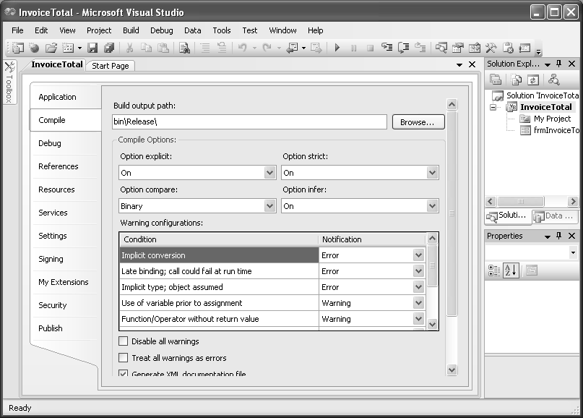
The Compile Properties
Tools>Options – Projects and Solutions, VB Defaults group, Option strict: ON

