Slide 1
CSIS 3470 Application Development
Get the tentative syllabus (front).
Complete Information Sheet (end of syllabus).
Read syllabus and identify:
One thing you like that is crystal clear,
One thing that is confusing, and
Any errors or something you would like to change.

Slide 4
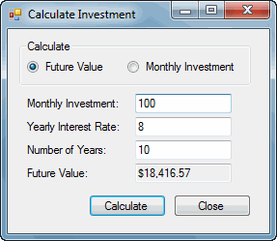

Slide 5
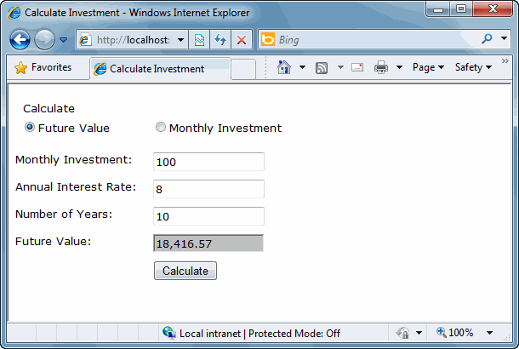

Slide 11
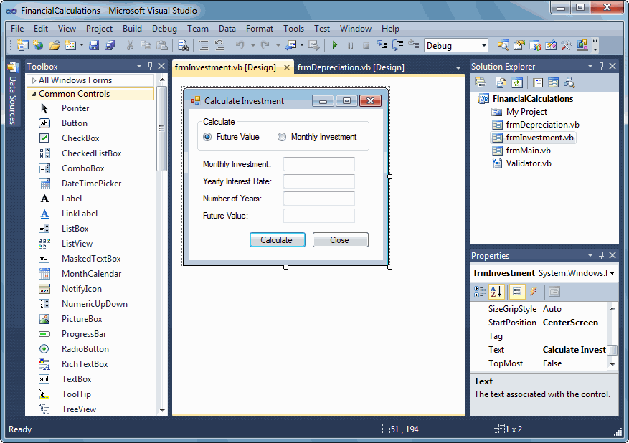

Slide 12
Lab Exercises
Download & install Murach’s files (Appendix A).
Course Applications folder
Tour the Visual Studio IDE

Slide 16
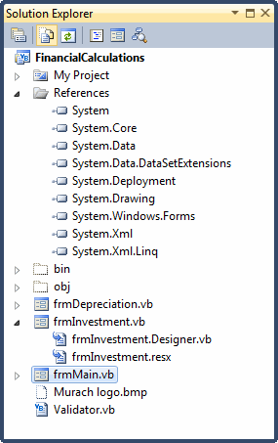

Slide 19
Write program.
Build assembly.
Run assembly.

Slide 22
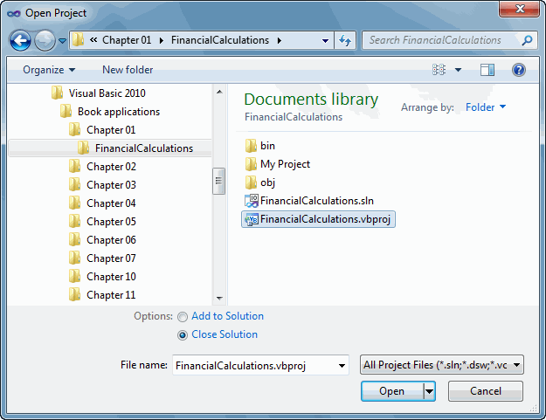
Project and Solution Concepts
.vbproj – project file tracks files
Related to project
Settings for project
.sln – solution file tracks all projects in the solution

Slide 24
