Slide 1
File Processing
Creating & Reading Text Files

Slide 2
Storing Data in Text Files: With VB 2008
File>New Project>WindowsFormApplication
(provide a project name)
Highlight project name in Solution Explorer.
Add>New Item
Select Text File icon> provide name
Type in data values, one per line
Save All

Slide 3
Data for text file: Payroll.txt
Sandy Kinnery
9.35
35
Judy Mollica
10.75
33

Slide 4
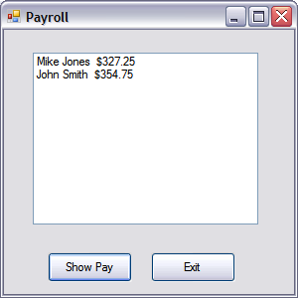
Problem: Calculate Payroll

Slide 5
Syntax to Read in Data Sequentially from File
Dim readerVar As IO.StreamReader
readerVar = IO.File.OpenText(filespec)
Varname = readerVar.ReadLine
filespec must include the full pathname unless the file is in
ProjectFolderName/bin/Debug

Slide 6
Code In Button Click-Event
Dim readerVar As IO.StreamReader
Dim strName As String
Dim decHourlyWage As Decimal
Dim decHoursWorked As Decimal
Dim decSalary As Decimal
readerVar = IO.File.OpenText("Payroll.txt")

Slide 7
Read in Data from Text File
strName = readerVar.ReadLine
decHourlyWage = CDec(readerVar.ReadLine)
decHoursWorked = CDec(readerVar.ReadLine)
decSalary = decHourlyWage * decHoursWorked

Slide 8
Display Results in a ListBox
lstResults.Items.Add(strName & " " & _ FormatCurrency(decSalary))
readerVar.Close()

Slide 9
Peek Method of StreamReader Class: Returns -1 when EOF
readerVar = IO.File.OpenText("Payroll.txt")
Do While readerVar.Peek <> -1
strName = readerVar.ReadLine
decHourlyWage = CDec(readerVar.ReadLine)
decHoursWorked = CDec(readerVar.ReadLine)
decSalary = decHourlyWage * decHoursWorked
lstResults.Items.Add(strName & " " & _
FormatCurrency(decSalary))
Loop
readerVar.Close()

Slide 10
Text Readings
ListBox – pp. 294-299
Text Files – pp. 658-671
Not exactly what we’ve done today

