Slide 1
File Processing
Creating Sequential Files,
Adding Data, &
Deleting Data

Slide 2
Creating a Sequential File
Filename
156 alphanumeric characters (including spaces & periods)
Three character extension identifying file type
Filespec
Includes full path
Default – no need to include full path
Current project
Debug/bin

Slide 3
Creating a Sequential File
Execute statement of the form
Dim sw As IO.StreamWriter = IO.File.CreateText (filespec)
Where sw is a variable name.
Setup a new line of data in a temporary buffer
sw.WriteLine (datum)
Transfer the new line of data to disk & sever communication
sw.Close()

Slide 4
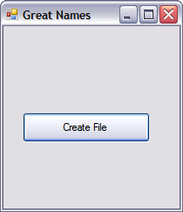
Example

Slide 5
Create File Button Click Event
Dim sw As IO.StreamWriter =IO.File.CreateText("GreatNames.txt")
sw.WriteLine("Atanasoff")
sw.WriteLine("Babbage")
sw.WriteLine("Codd")
sw.Close()
MessageBox.Show("Names Recorded", "file Status")

Slide 6
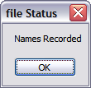
Results

Slide 7
Open GreatNames.txt

Slide 8
Add Items to Existing File
Execute statement
Dim sw As IO.StreamWriter=IO.File.AppendText(filespec)
Use WriteLine method to place data into file.
Close the file with the statement
sw.Close()

Slide 9
Dim sw As IO.StreamWriter=IO.File.AppendText(filespec)
Appends data to the end of file
Creates file if one does not exist

Slide 10
Three Mutually Exclusive File Handling Modes for Sequential Files
CreateText
OpenText
AppendText

Slide 11
Avoid Opening a Nonexistent File
IO.File.Exists(filespec)
Method Returns True or False
True indicates file exists

Slide 12
Code to Open File with Test for Existence
Dim strMessage As String
Dim sr As IO.StreamReader
If IO.File.Exists("GreatNames.txt") Then
sr = IO.File.OpenText("GreatNames.txt")
Else
strMessage = "Either no file has yet been created or the file "
strMessage &= "GreatNames.txt" & " is not where expected."
MessageBox.Show(strMessage, "File Not Found")
End If

Slide 13
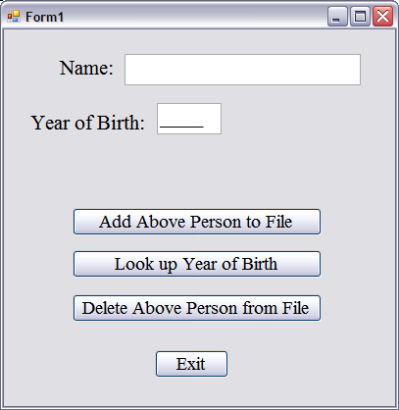
Lab Exercise – CE6 Download & Unzip YOB.zip

