Slide 2
How to Declare and Instantiate an Array

Slide 4
What if you do not know the size needed?

Slide 10
How to reference the elements of an array?

Slide 15
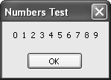

Slide 17
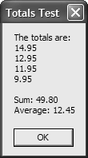

Slide 18
To Enhance Your Understanding
Read pp. 223-229
Do Exercise 8-1 #1-3

Slide 22
To Enhance Your Understanding
Read pp. 223-231
Do Exercise 8-1 #1-7

Slide 23
Syntax for Rectangular Arrays

Slide 27
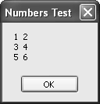

Slide 28
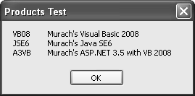

Slide 29
To Enhance Your Understanding
Read pp. 223-235
Do Exercise 8-2

Slide 33
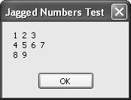

Slide 34
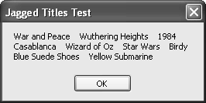

Slide 38
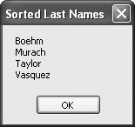

Slide 55
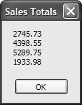

Slide 57
To Enhance your Learning:
Read pp. 252-253
Do Exercise 8-1, # 9 & 10

Slide 58
The SortedList() Class
Uses a key to access each element
Inefficient for sequential access
Efficient for insertinf elements into the list
Sorted key order maintained automatically

Slide 59
KeyValuePair Structure
Two Properties
Key
Value
Value can store
Value type or
Reference type

Slide 65
Lab Assignment
Create a project that will test the code on p. 255
Create a form with an appropriate interface to work with the code.
Allow the user to enter key value pairs on the form.
Allow the user to specify for whom they wish to search.
Allow the user to request a display of the data.
Test the code only. Do not worry about validating data, etc.

Slide 68
Lab Assignment, Queue
Create a project that will test the code on p. 257
Create a form with an appropriate interface to work with the code.
Allow the user to enter names to put in the queue.
Allow the user to specify for whom they wish to search (code not supplied).
Allow the user to request a display of the names in the queue.
Test the code only. Do not worry about validating data, etc.

Slide 70
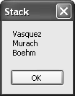

Slide 71
ArrayList
Is an Untyped collection (legacy)
Works mostly like a List()
Is not on test

Slide 72
Lab Assignment, Stacks
Create a project that will test the code on p. 257
Create a form with an appropriate interface to work with the code.
Allow the user to enter names to put in the stack.
Allow the user to specify for whom they wish to search (code not supplied).
Allow the user to request a display of the names in the stack.
Allow the user to “peek.”
Test the code only. Do not worry about validating data, etc.

