Slide 2
Testing for Valid Numeric Input

Slide 3
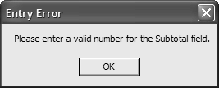

Slide 4
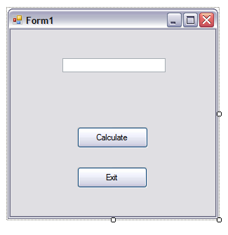
Create a project including the form below.
Name the text box,
txtTest.
Code the Exit button.

Slide 5
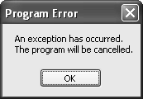

Slide 7
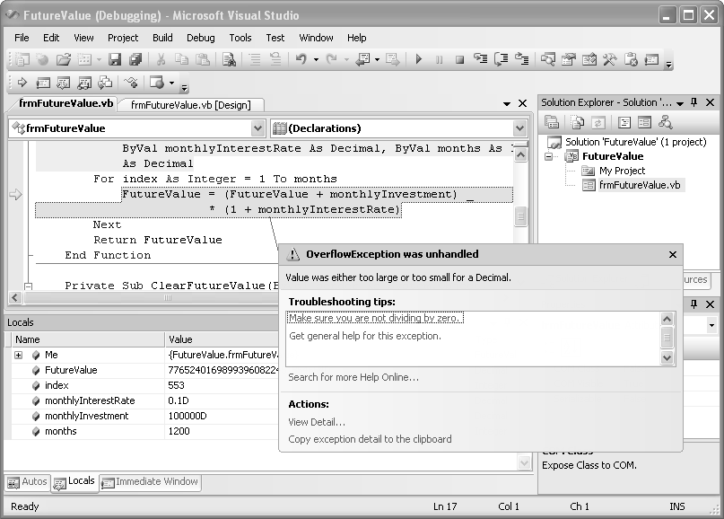

Slide 10
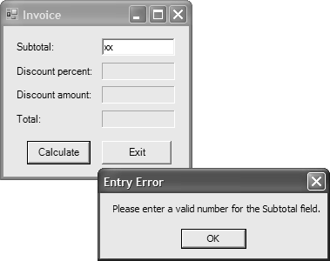

Slide 12
An Exception is an Object with
Properties
Methods

Slide 15
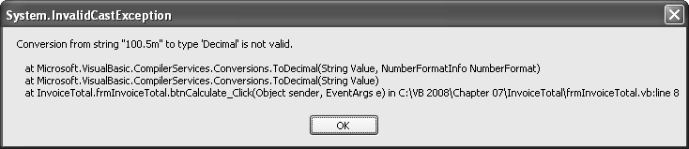

Slide 16
Practice Exercise
Create a project that will allow you to test the code on Slide 14.
The code should be activated when a button is clicked.
What is accomplished by the last argument of MessageBox.Show, ex.GetType.ToString?

Slide 20
Convert Class vs. Conversion Functions
CInt(10.5) rounds to 10 – always rounds
Convert.ToInt32(10.5) – throws a Format Exception
Which do you want?
CInt(x) – throws an Invalid Cast Exception

Slide 31
Do #1-4 on page 221

Slide 32
Data Validation: Three Common Types
Did the user enter anything?
Did the entry convert to the required data type?
Was the entry within the required range?

Slide 37
Data Validation for All User Input
Code for all three common checks for every textbox
Is there an easier method?

Slide 46
To Learn More:
Do p. 221 Exercise 7-1 #1-7 (In #5, use only a single Return statement.)
Do p. 222 Exercise 7-2 #1-7

