Slide 1
Basic SQL Statements Oracle/SQL Plus Commands
Kroenke, 11th ed., Chapter Two

Slide 2
Relational Database Concept
Model proposed
E. F. Codd
1970
Basis for Relational Database Management Systems (RDMS)
Basis for Oracle

Slide 3
The Key Characteristic of Databases: Related Tables

Slide 4
Relational Database Definition
A self-describing collection of integrated relations.
Table: DEPT
Table: EMP
DEPTNO | DNAME | LOC
10 | ACCOUNTING | NEW YORK
20 | RESEARCH | DALLAS
30 | SALES | CHICAGO
40 | OPERATIONS | BOSTON
EMPNO | ENAME | JOB | DEPTNO
7839 | KING | PRESIDENT | 10
7698 | BLAKE | MANAGER | 30
7782 | CLARK | MANAGER | 10
7566 | JONES | MANAGER | 20

Slide 5
The Relational Model
Collection of objects or relations to store data & describe the database.
Set of operators to act on relations
Data integrity constraints to govern related tables

Slide 6
Structured Query Language
SQL(sequel)
Communicate with server to
Access,
Manipulate, and
Control data

Slide 7
SELECT Statements
Access Data
Produce tables

Slide 8
Capabilities of SELECT Statements
Selection: returns rows restricted by some criteria
Projection: returns specified columns
Join: brings together rows in different tables.

Slide 9
Capabilities of SQL SELECT Statements
Selection
Projection
Table 1
Table 1

Slide 10
Capabilities of SQL SELECT Statements
Join
Table 2
Table 1

Slide 11
Relational Algebra Module

Slide 12
The Results of an SQL SELECT Statement
Is a table!!!
Never puts stuff into existing tables

Slide 13
Basic SELECT Statement
SELECT [DISTINCT] {*, column [alias], . . .}
FROM table;
SELECT identifies what columns.
FROM identifies which table.

Slide 14
Finding Oracle
Programming Applications folder on desktop
Oracle – OraDB11g-home1 folder
Application Development folder
SQL Plus

Slide 15
To Log On
tiger

Slide 16
Some Uses for Spool Files
Can be viewed in NotePad or Word
Can be edited to create the same changes on another computer
Delete everything except SQL statements
At home, run the edited file.
Start fullpathfilename

Slide 17
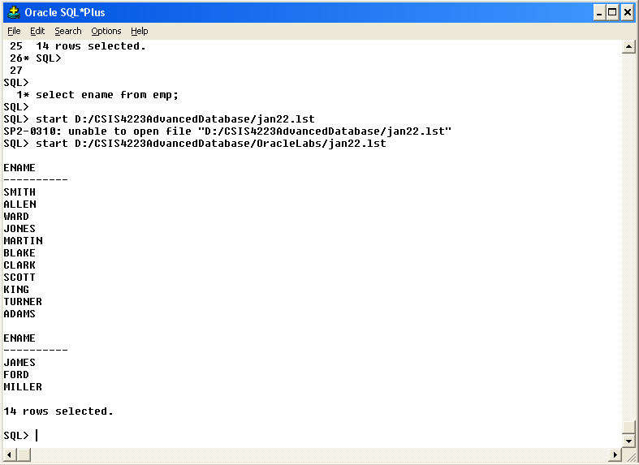
Using the spool file→ Look at the file name (no spaces in the path)

Slide 18
Column Heading Defaults of Three Data Types
Date and character data
Left justified
Upper case
Date → DD-MON-YY
Numeric data
Right justified
Upper case

Slide 19
Arithmetic Expressions
Create new values
From base table data
Do not change base table data

Slide 20
Operator Precedence Like Algebra
Evaluate * and / before + and -
Evaluate from left to right
Parenthesis override
No exponentiation operator exists

Slide 21
Null Values
Unavailable, unassigned, inapplicable
NOT the same as zero or blank
Defined within the context of specific database
Nvl(column, value)

Slide 22
Column Aliases
Two formats
SELECT column AS alias
SELECT column alias
Be consistent in style
Double quotes around the alias allow
Mixed case
Spaces

Slide 23
DESCRIBE tablename
Describes structure of existing table
A SQL Plus command

Slide 24
Datatype | Description
NUMBER(p.s) | Number value having a maximum number of digits p . the number of digits to the right of the decimal point s
VARCHAR2(s) | Variable-length character value of maximum size s
DATE | Date and time value between Jan. 1, 4712 B.C. and Dec. 31, 9999 A.D.
CHAR(s) | Fixed-length character value of size s

Slide 25
SQL*Plus File Commands
SAVE filename
GET filename
START filename
@ filename
EDIT filename
SPOOL filename
EXIT

Slide 26
SQL Statements vs SQL*Plus Commands
SQL
A language
ANSI standard
Keyword NOT abbreviated
Statements manipulate data & table definitions in DB
SQL*Plus
An environment
Oracle proprietary
Keywords can be abbreviated
Commands do NOT manipulate table structure or values in DB

Slide 27
SQL Statements
SQL Statements
Buffer
Server
SQL*Plus
-----
------
------
------
Query Results
SQL*Plus Commands
Formatted Report

Slide 28
Do Practice 1
Practice 1 – Basic SQL SELECT Statements.doc

