Slide 2
CSIS 3222 – Database Systems
Get syllabus (front).
Complete Information Sheet (end of syllabus).
Read syllabus and identify:
One thing you like that is crystal clear,
One thing that is confusing, and
Any errors or something you would like to change.

Slide 3
Technology in Action
Chapter 11
Behind the Scenes: Databases and Information Systems
Notes:
This chapter explores the basic building blocks from which databases are created. We discuss important features of databases and the types of database programs organizations use. We also discuss the various types of information systems that use databases and explore modern data storage designs, such as data warehouses. Finally, we examine how data can be further analyzed (or “mined”) to yield information beyond the original scope of the database design.

Slide 4
Topics
Databases and their uses
Database components
Types of databases
Database management systems
Relational databases
Notes:
Chapter topics include:
Databases and their uses
Database components
Types of databases
Database management systems
Relational databases
Data warehouses and data marts
Information systems
Data mining

Slide 5
Problems with Two Lists???

Slide 6
Databases
Collections of related data
Easily stored, sorted, organized, and queried data
The basis for information
Notes:
Databases are collections of related data that can be easily stored, sorted, organized, and queried.
By creating an organized structure for data, we hope to make data more meaningful and therefore more useful. In other words, we are attempting to turn data into information.

Slide 7
Advantages of Using Databases
Data centralization
Easily shared data
Large quantities of data available
Data integrity
Flexible use of data
Notes:
Without databases, you could not store and retrieve large quantities of information easily. Even very large databases can provide the information you request in seconds.
Databases provide additional advantages:
They enable information sharing.
They provide data centralization.
They promote data integrity.
They allow the flexible use of data.

Slide 8
Flexible Use of Data in Applications

Slide 9
Disadvantages of Databases
Complex to construct
Time consuming
Expensive
Privacy concerns
Notes:
Databases are more complex to construct and administer than lists are.
Databases can be time consuming and expensive to set up. It is helpful to have an experienced database administrator assist with the construction of large databases.
Data privacy concerns arise when using databases.
Despite the increased complexity of databases and the issues surrounding privacy, however, the advantages of databases far outweigh the administrative disadvantages.

Slide 10
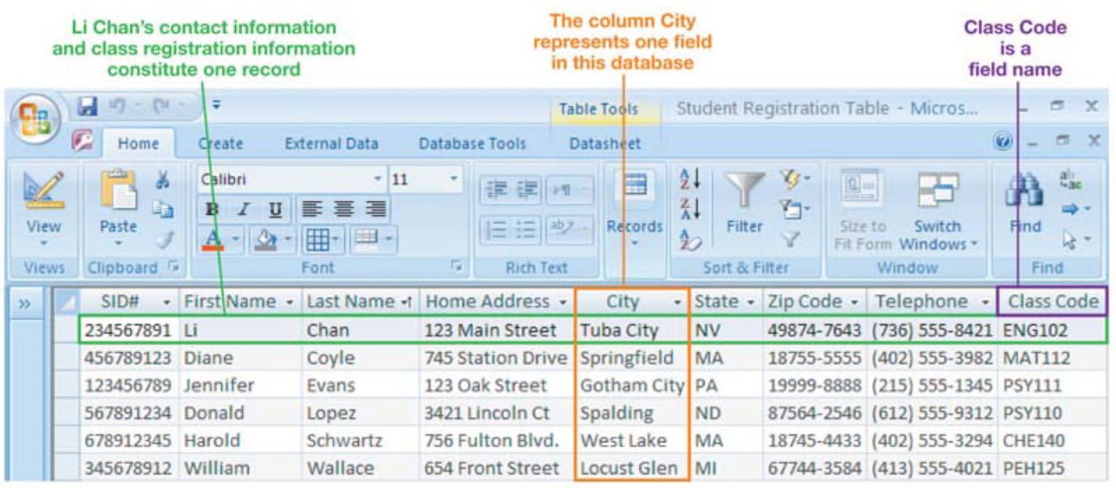
Database Terminology
Field: Category of information, displayed in columns
Notes:
A category of information in a database is stored in a field. Fields are displayed in columns.
Each field is identified by a field name, which is a way of describing the field.
In a database, fields have other characteristics (aside from the field name) that describe them, such as field data type and field size.

Slide 11
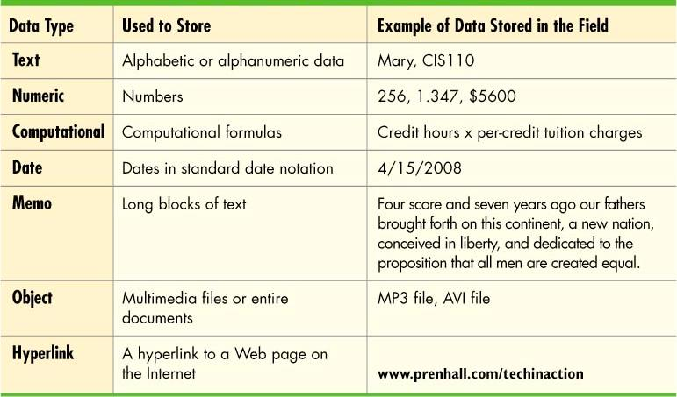
Database Terminology
Data type: Type of data that can be stored in a field
Notes:
When fields are created in a database, the user assigns those fields a data type. The data type indicates what type of data can be stored in the field. Common data types are as follows:
Text fields hold any combination of letters or numbers and are most often used to hold text. Although text fields can contain numbers (such as telephone numbers), they are stored as text and therefore cannot be used for numbers that will be used in calculations.
Numeric fields store numbers. Values in numeric fields can be used to perform calculations. In MS Access, currency is handled as a separate data type.
Computational fields are numeric fields that store the contents of a calculation, which is generated with a formula in the numeric field. This is similar to a formula computation in a spreadsheet cell.
Date fields hold date data, such as birthdays and due dates.
Memo fields are text fields used to hold long pieces of text.
Object fields hold objects, such as pictures, video clips, or entire documents.
Hyperlink fields store hyperlinks to Web pages.
Access adds two other data types, AutoNumber and Lookup Wizard. AutoNumber counts records as they are added, and Lookup Wizard creates a lookup field.

Slide 12
Database Terminology
Record: A group of related fields
Record
Notes:
A group of data pertaining to one entity across related fields is called a record.

Slide 13
Database Terminology
Table: A group of related records
Table
Notes:
A group of related records is called a table. Tables usually are organized by a common subject.

Slide 14
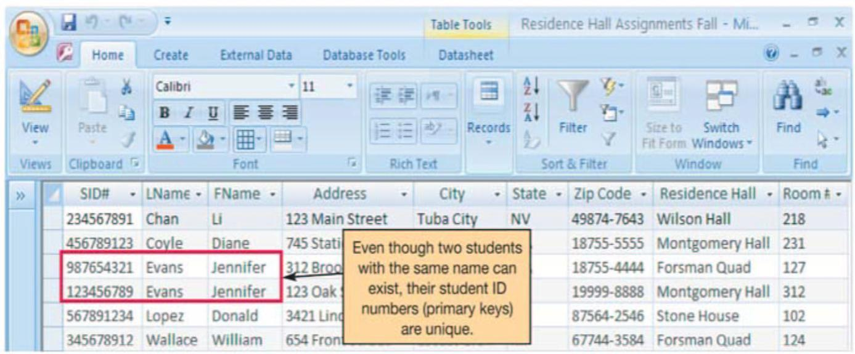
Database Terminology
Primary key: A field value unique to a record
Primary Key
Notes:
To keep database records distinct, each record must have one field that has a value unique to that record. This unique field is called a primary key. Establishing a primary key and ensuring that it is unique makes it impossible to duplicate records.

Slide 15
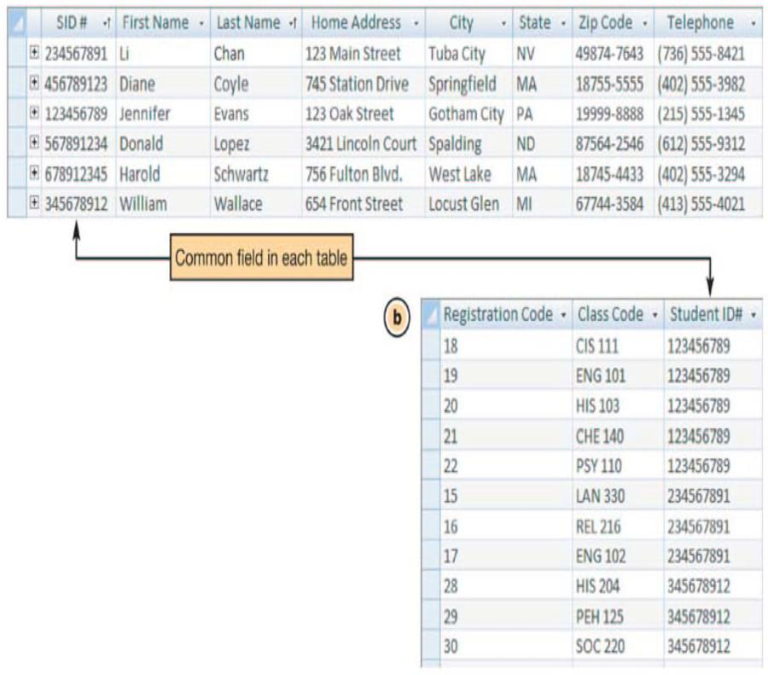
Relational Database Operations
Organize data into tables
Relationships are links between tables with related data
Common fields need to exist between tables
Notes:
Relational databases operate by organizing data into various tables based on logical groupings.
In relational databases, the links between tables that define how the data is related are referred to as relationships.
To establish a relationship between two tables, the tables must have a common field (or column).

Slide 16
Database Types
Relational databases
Organize data in tables
Link tables to each other through their primary keys
Object-oriented databases
Store data in objects
Also store methods for processing data
Handle unstructured data
Notes:
The three major types of databases in use are relational, object-oriented, and multidimensional databases. Of these three, relational databases have the largest market share.
A relational database organizes data in table format by logically grouping similar data into relations (or tables that contain related data). In relational databases, tables are logically linked to each other by including their primary keys in other tables with related information.
An object-oriented database stores data in objects, not in tables. Objects contain not only data, but also methods for processing or manipulating that data. This allows object-oriented databases to store more types of data (such as unstructured data) and to access that data faster than relational databases do.

Slide 17
Database Types
Multidimensional databases
Store data in multiple dimensions
Organize data in a cube format
Can easily be customized
Process data much faster
Notes:
A multidimensional database stores data in multiple dimensions, as opposed to a relational database, which stores data in two-dimensional tables.
Multidimensional databases organize data in a cube format. Each data cube has a measure attribute, which is the main type of data the cube is tracking.
The two main advantages of multidimensional databases are that they can easily be customized to provide information to a variety of users, and they can process data much faster than pure relational databases can.

Slide 18
Database System Components
Applications

Slide 19
Database System Components
Applications, computer programs (users run)
Database Management System (DBMS)
Creates databases, tables, supporting structures
Processes databases
Administers databases
Database
Structured Query Language (SQL)

Slide 20
All rights reserved. No part of this publication may be reproduced, stored in a retrieval system, or transmitted, in any form or by any means, electronic, mechanical, photocopying, recording, or otherwise, without the prior written permission of the publisher. Printed in the United States of America.
Copyright © 2010 Pearson Education, Inc.
Publishing as Prentice Hall
20

