Slide 1
Chapter 7: Internet-Based Applications
Business Data Communications, 6e

Slide 2
Electronic Mail Features
Message Preparation
Word processing
Annotation
Message Sending
User directory
Timed delivery
Multiple addressing
Message priority
Status information
Interface to other facilities
Message Receiving
Mailbox scanning
Message selection
Message notification
Message reply
Message rerouting

Slide 3
Single System E-Mail
Only allows users of a shared system to exchange messages
Each user has unique identifier and mailbox
Sending a message simply puts it into recipients’ box
Example: AOL

Slide 4
Multiple Systems E-Mail
Distributed system enables mail servers to connect over a network to exchange mail
Functions split
User agent handles preparation, submission, reading, filing, etc
Transfer agent receives mail from user, determines routing, communicates with remote systems
Interconnection requires standards

Slide 5
Common Email Standards
Post Office Protocol (POP3): permits an email client to download messages from a server using TCP/IP (typically port 110).
Internet Mail Access Protocol (IMAP): similar to POP3, with stronger authentication and additional functions (typically port 143).
Simple Mail Transfer Protocol (SMTP): used for transfer of mail from one user agent (UA) to a message transfer agent (MTA) and from one MTA to another.
Multipurpose Internet Mail Extensions (MIME): supplements SMTP and allows encapsulation of multimedia.

Slide 6
Simple Mail Transfer Protocol (SMTP)
Standard for TCP/IP mail transfer, defined in RFC 821
Concerned addressing and delivery, not content, with two exceptions
Character set standardized as 7-bit ASCII
Adds log information to message that indicates message path

Slide 7
Basic E-Mail Operation
User creates message with user agent program
Text includes RFC 822 header and body of message
List of destinations derived from header
Messages are queued and sent to SMTP sender program running on a host

Slide 8
SMTP Mail Flow
SMTP server transmits messages to appropriate hosts via TCP
Multiple messages to same host can be sent on one connection
Errors handling necessary for faulty addresses and unreachable hosts
SMTP protocol attempts to provide error-free transmission, but does not provide end-to-end acknowledgement
SMTP receiver accepts messages, places it in mailbox or forwards

Slide 9
SMTP Connection Setup
Sender opens TCP connection to receiver
Receiver acknowledges connection with “220 Service Ready” or “421 Service Not Available”
If connection is made, sender identifies itself with the “HELO” command
Receiver accepts identification with “250 OK”

Slide 10
SMTP Mail Transfer
MAIL command identifies originator, provides reverse path for error reporting
RCPT commands identify recipient(s) for message
Receiver has several positive or negative responses to RCPT
Sender will not send message until it is sure at least one copy can be delivered
DATA command transfers message

Slide 11
Sample SMTP Exchange
S: MAILFROM:<Smith@Alpha.ARPA> R: 250 OK
S: RCPT TO:<Jones@Beta.ARPA> R: 250 OK
S: RCPT TO:<Green@Beta.ARPA> R: 550 No such user here
S: DATA R: 354 Start mail input; end with <CRLF>.<CRLF> S: Blah blah blah…. S:…etc. etc. etc. S: <CRLF>.<CRLF> R: 250 OK

Slide 12
SMTP Connection Closing
Sender sends a QUIT command to initiate TCP close operation
Receiver sends a reply to the QUIT command, then initiates its own close

Slide 13
RFC 822
Defines format for text messages via electronic mail
Used by SMTP as accepted mail format
Specifies both envelope and contents
Includes a variety of headers that can be included in the message header lines

Slide 14
Limitations of SMTP and RFC822
Cannot transmit executables or binary files without conversion into text through non-standard programs (e.g. UUENCODE)
Cannot transmit diacritical marks
Transfers limited in size
Gateways do not always map properly between EBCDIC and ASCII
Cannot handle non-text data in X.400 messages
Not all SMTP implementations adhere completely to RFC821 (tabs, truncation, etc)

Slide 15
MIME (Multipurpose Internet Mail Extensions)
Intended to resolve problems with SMTP and RFC822
Specifies five new header fields, providing info about body of message
Defines multiple content formats
Defines encodings to enable conversion of any type of content into transferable form

Slide 16
MIME Header Fields
MIME-Version: Indicates compliance with RFCs 1521 and 1522
Content-Type: Describes data in sufficient detail for receiver to pick method for representation
Content-Transfer-Encoding: Indicates type of transformation used to represent content
Content-ID: Used to uniquely identify MIME entities
Content-Description: Plain text description for use when object is not readable

Slide 17
MIME Content Types
Seven major types: Text, Multipart, Message, Image, Video, Audio, Application
Fourteen subtypes: plain, mixed, parallel, alternative, digest, rfc822, partial, external body, jpeg, gif. Mpeg, basic, postscript, octet-stream
Multipart type indicates separate parts, such as text and an attachment
MIME types are used by web servers, as well

Slide 18
HTTP Overview
Stateless protocol
TCP connection terminated as soon as transaction completes
Flexible in format handling

Slide 19
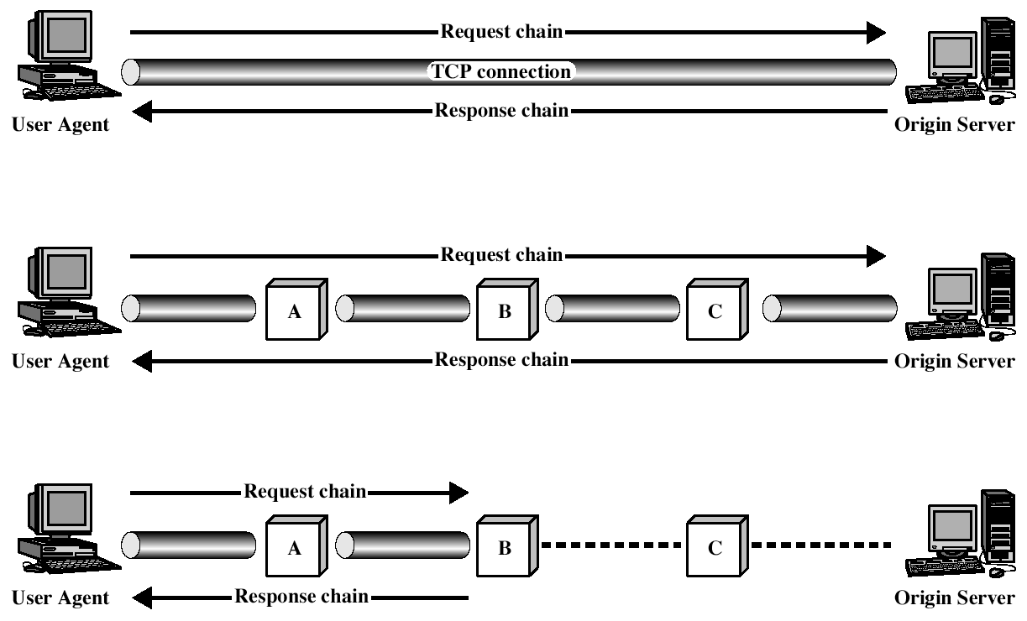
HTTP Operation

Slide 20
HTTP Intermediate Systems
Proxy
Forwarding agent; acts as a server to a client and a client to a server
Security intermediary (e.g., firewall)
Different versions of HTTP
Gateway
Security intermediary (e.g., firewall)
Non-HTTP server
Tunnel
Relay point between two TCP connections
Cache
Facility storing previous requests and responses

Slide 21
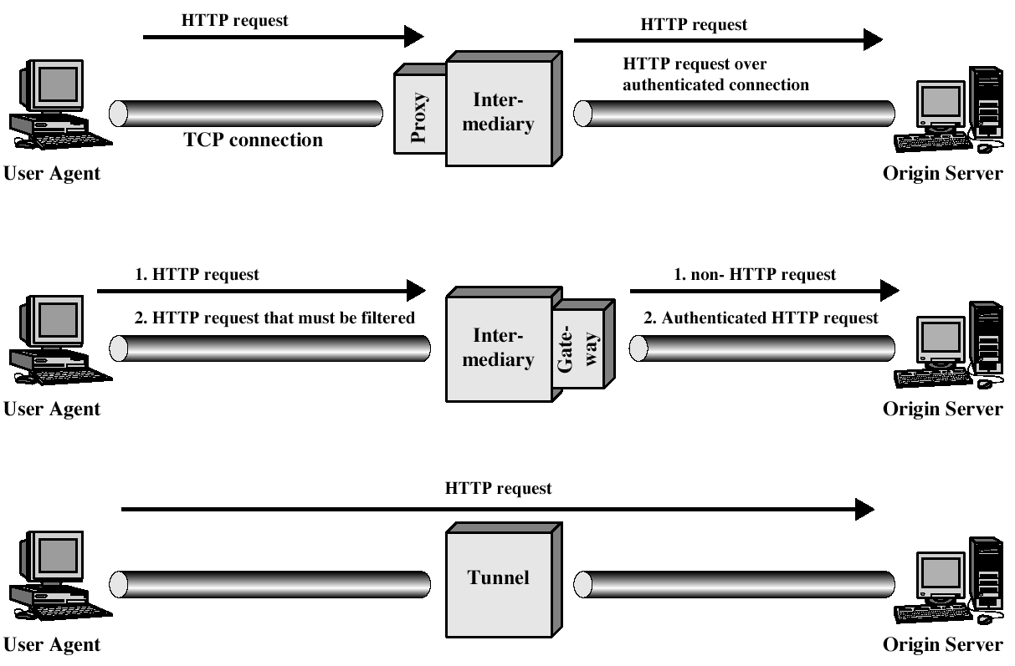
Intermediate System Examples

Slide 22
HTTP Messages
Simple Messages
Simple-Request: GET with requested URL
Simple-Response: block with requested info
Full Requests
Request-Line
Response-Line
General-Header
Request-Header
Entity-Header
Entity-Body
All HTTP headers follow RFC 822 format

Slide 23
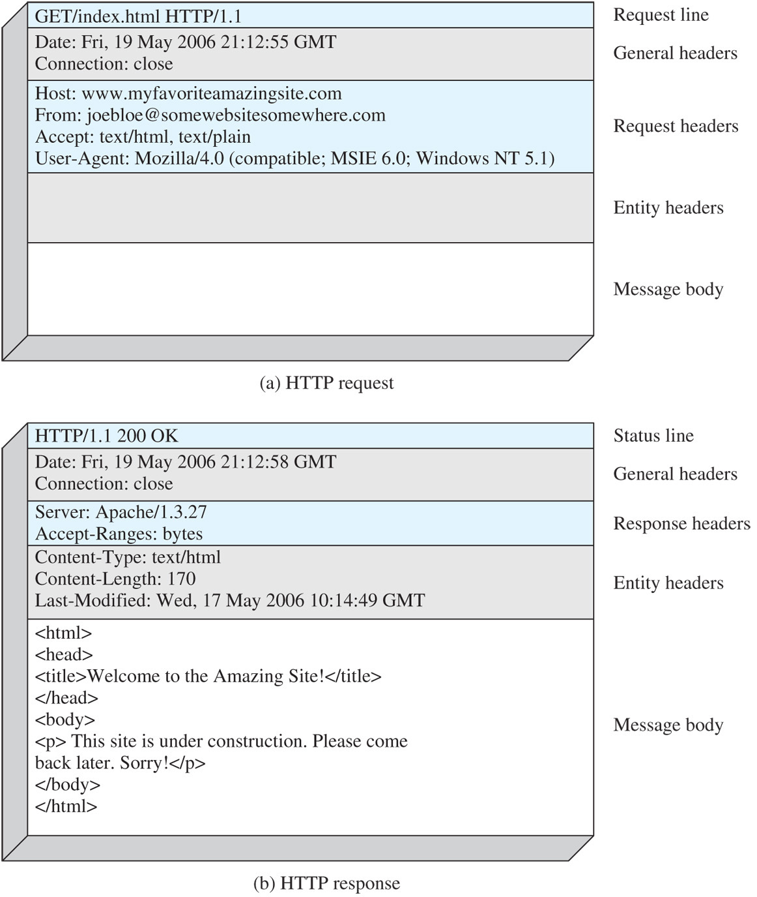
HTTP Message Format Example

Slide 24
Web Security Challenges
Web servers are vulnerable to attack
Web is highly visible. Corporate reputations can be damaged by attacks.
Complex web software may hide security flaws.
Web server exploitation can lead to attacks across a corporate network.
Users are not necessarily aware of security risks.

Slide 25
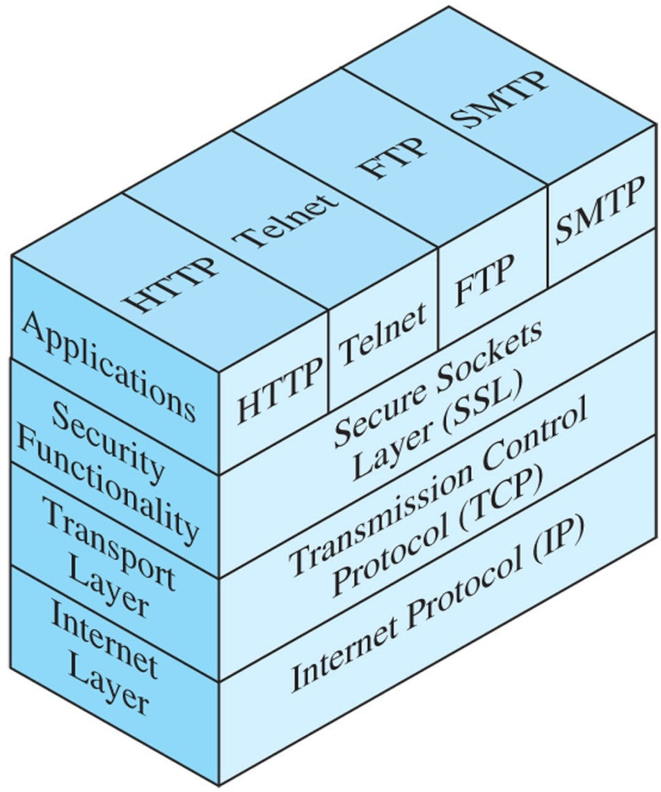
Secure Socket Layers (SSL)
Socket: a method of directing data to an appropriate application.
SSL provides 3 categories of security: - Confidentiality - Message Integrity - Authentication

Slide 26
HTTPS
Combination of HTTP and SSL for secure communication between a Web browser and Web server.
Provides encrypted communication of: -URL of the requested document -Contents of the document -Contents of browser forms -Cookies -Contents of the HTTP Header

Slide 27
Session Initiation Protocol (SIP)
Defined in RFC 3261
Manages real-time sessions over IP data network
Intended to enable Internet telephony/VoIP
Based on HTTP-like request/response transaction model
Five facets
User location
User availability
User capabilities
Session setup
Session management

Slide 28
SIP Components and Protocols
Client/server elements
Client sends/receives SIP messages
Includes user agents, proxies
Network elements
User agent (client/UAC, server/UAS)
Redirect server
Proxy server
Registrar
Location service

Slide 29
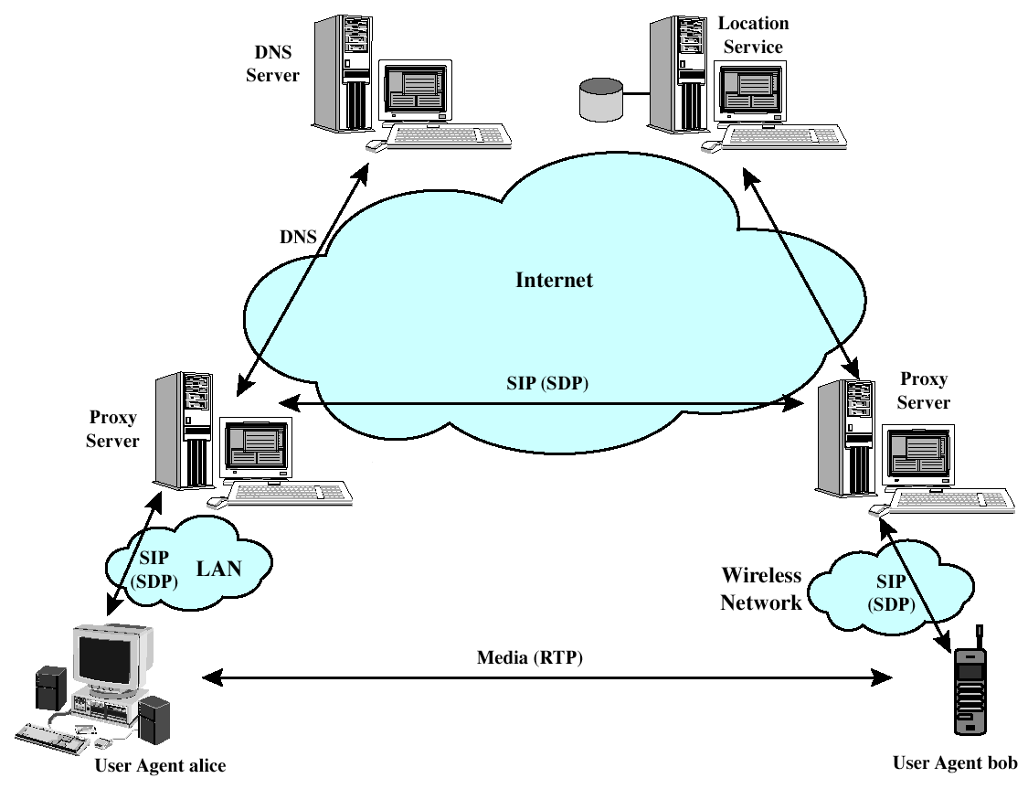
SIP Component Illustration

Slide 30
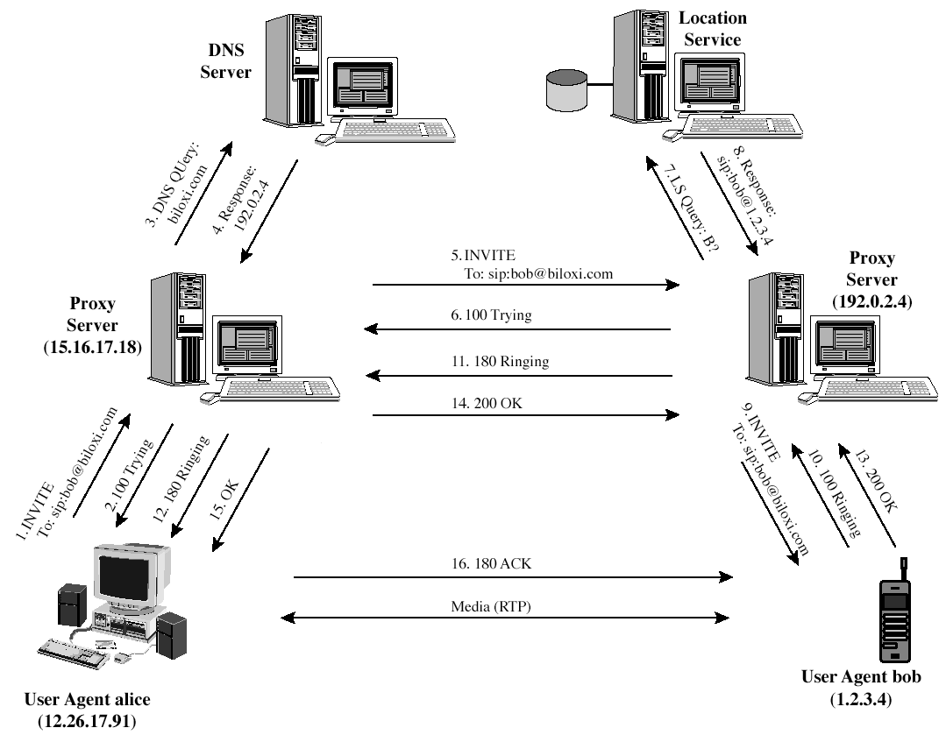
SIP Operation

Slide 31
SIP Messages
Request Methods
REGISTER
INVITE
ACK
CANCEL
BYE
OPTIONS
Response Types
Provisional (1xx)
Success (2xx)
Redirection (3xx)
Client Error (4xx)
Server Error (5xx)
Global Failure (6xx)

Slide 32
Session Description Protocol
Media Streams
Addresses
Ports
Payload types
Start and stop times
Originator

