Slide 1
Chapter 18: Computer and Network Security Threats
Business Data Communications, 6e

Slide 2
Computer Security Defined
Computer Security: The protection afforded to an automated information system in order to attain the applicable objectives of preserving the integrity, availability, and confidentiality of information system resources (includes hardware, software, firmware, information/data, and telecommunications) source: NIST Computer Security Handbook

Slide 3
3 Key Security Objectives
Confidentiality -Data Confidentiality: assures that private information is not disclosed to unauthorized individuals -Privacy: assures that individuals control information related to them
Integrity -Data integrity: assures that information and programs are only changed in a specified and authorized manner -System integrity: assures that a system performs its intended function in an unimpaired manner
Availability: assures that systems work promptly and service is not denied to authorized users.

Slide 4
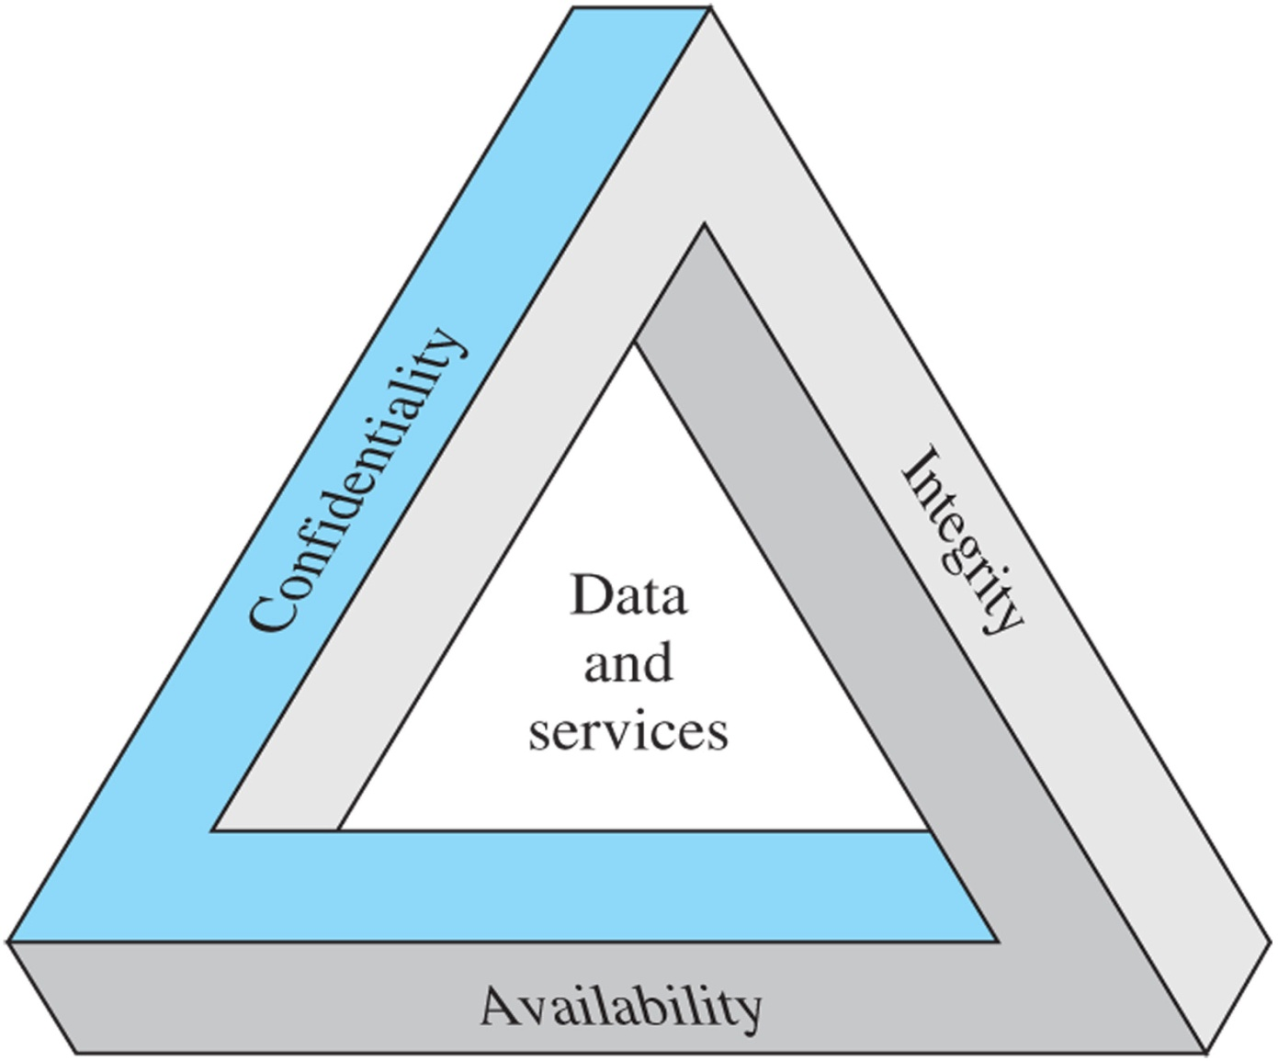
The Security Requirements Triad

Slide 5
Unauthorized Disclosure
Exposure: intentional release of sensitive information or gaining unauthorized knowledge of sensitive data.
Interception: unauthorized access to packets, email or other data traffic
Inference: gaining information from observing network traffic patterns
Intrusion: unauthoriz3ed access by overcoming the system’s access control protections.

Slide 6
Deception Threats
Masquerade: attempt to gain access by posing as an authorized user
Falsification: altering or replacing valid data or introducing false data into a file or database
Repudiation: a user denies sending data or a user denies receiving or possessing data

Slide 7
Disruption Threats
Incapacitation: attack on system availability; such as Trojan horses, viruses, or worms
Corruption: attack on system integrity; system resources or services function in an unintended manner
Obstruction: interfere with communications by disabling links or altering control information

Slide 8
Usurpation Threats
Misappropriation: includes theft of service; including distributed denial of service attacks
Misuse: can occur either by means of malicious logic or unauthorized system access.

Slide 9
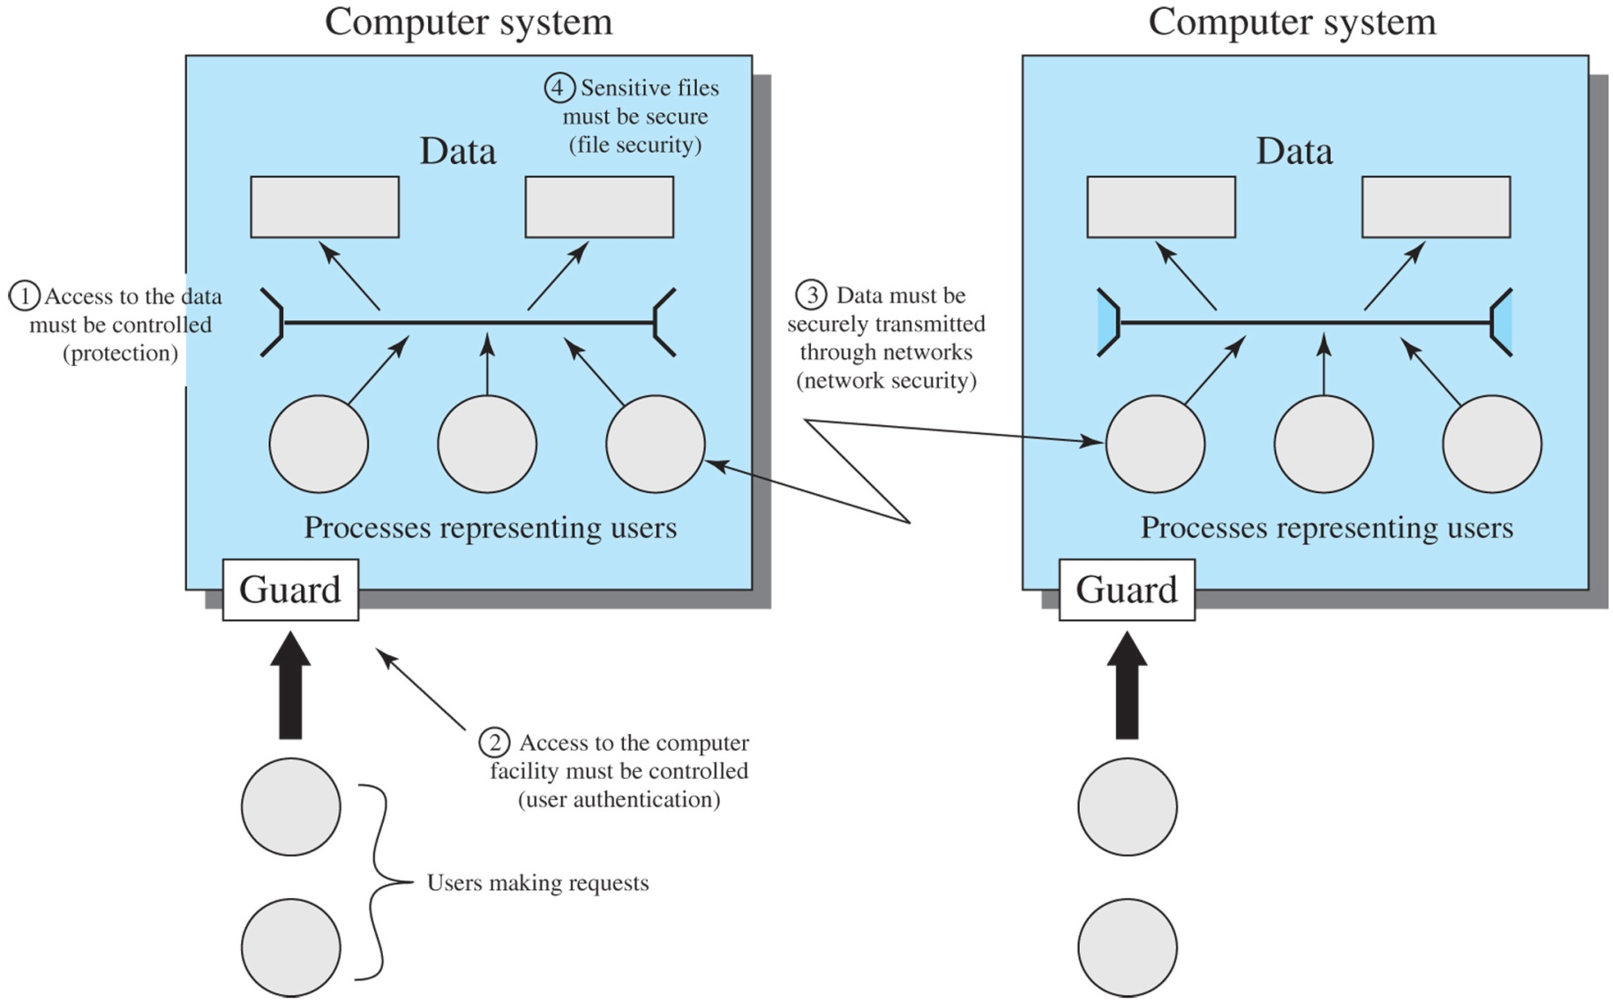
Scope of System Security

Slide 10
Threats and Assets
 | Availability | Confidentiality | Integrity
Hardware | Equipment is stolen or disabled, thus denying service.
Software | Programs are deleted, denying access to users. | An unauthorized copy of software is made. | A working program is modified, either to cause it to fail during execution or to cause it to do some unintended task.
Data | Files are deleted, denying access to users. | An unauthorized read of data is performed. An analysis of statistical data reveals underlying data. | Existing files are modified or new files are fabricated.
Communication Lines | Messages are destroyed or deleted. Communications lines or networks are rendered unavailable. | Messages are read. The traffic pattern of messages is observed. | Messages are modified, delayed, reordered, or duplicated. False messages are fabricated.

Slide 11
Security Threats
Passive attacks
Release of message contents
Traffic analysis
Difficult to detect because there is no data alteration
Emphasis on prevention through encryption
Active attacks
Masquerade
Replay
Modification of messages
Denial of Service

Slide 12
Intruders
Masquerader: an individual not authorized to use the computer and penetrates a system’s access controls to exploit a legitimate user’s account; likely to be an outsider.
Misfeasor: legitimate user who access data, programs or resources that they are not authorized for; likely to be an insider.
Clandestine user: individual who seizes supervisory control of the system and uses the access to evade auditing and access controls.

Slide 13
Intrusion Examples
Performing a remote root compromise of an e-mail server
Defacing a Web server
Guessing and cracking passwords
Copying a database containing credit card numbers
Viewing sensitive data without authorization
Running a packet sniffer on a workstation to capture usernames and passwords
Dialing into an unsecured modem and gaining internal network access
Posing as an executive, calling the help desk, resetting the executive’s e-mail password, and learning the new password
Using an unattended, logged-in workstation without permission

Slide 14
Intruder Behavior Patterns
Hackers: Organized group of intruders who hack into a computer for the thrill or for status.
Criminals: Usually have specific targets or classes of targets in mind. Frequently Eastern European or Southeast Asian groups who do business on the Web.
Insider Attacks: Difficult to detect and protect against; employees have access to and knowledge of the structure and content of databases.

Slide 15
Malicious Software
Malware: malicious software that exploit system vulnerabilities
Two categories: those that need a host program and those that are independent (parasitic)
May or may not replicate

Slide 16
Malicious Programs
Backdoor: secret entry point into a program that allows someone to gain access. A maintenance hook is a backdoor inserted by a programmer to aid in testing and debugging.
Logic Bomb: code embedded in a program that is set to go off when certain conditions are met.

Slide 17
Malicious Programs
Trojan Horse: use program or command procedure that contains hidden code that when invoked performs some unwanted or harmful procedure. These may also be used for data destruction.
Mobile Code: programs that can be shipped unchanged to a heterogeneous collection of platforms and execute identical semantics.

Slide 18
Malicious Programs
Viruses: software that can infect other programs by modifying them. The infection may be passed onto other programs.
Virus has three parts: -Infection mechanism -Trigger -Payload

Slide 19
Virus Phases
Dormant Phase: virus is idle.
Propagation Phase: virus places an identical copy of itself on other programs, each program will then place a copy into other programs
Triggering Phase: virus is activated to perform the function for which it was intended.
Execution Phase: the function is performed.

Slide 20
Virus Classifications
By Target -Boot Sector Infector -File Infector -Macro Virus
By Concealment Strategy -Encrypted Virus -Stealth Virus -Polymorphic Virus -Metamorphic Virus

Slide 21
Worms
Worms replicate themselves and send copies from computer to computer across a network connection to perform some unwanted function.
A network worm may also attempt to determine if a system has previously been infected before copying itself.

Slide 22
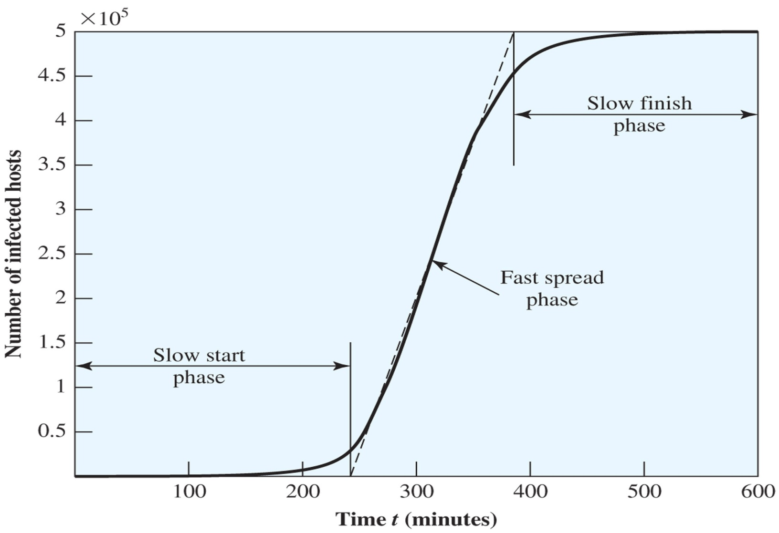
Worm Propagation Model

Slide 23
State of Worm Technology
Multiplatform
Multiexploit
Ultrafast spreading
Polymorphic
Metamorphic
Transport Vehicles
Zero-day exploit

Slide 24
Bots
Also know as a zombie or drone
Program that secretly takes another Internet-attached computer, then uses it to launch attacks that are difficult to trace
A botnet is a collection of bots capable of coordinating attacks

Slide 25
Uses of Bots
Distributed denial-of-service attacks
Spamming
Sniffing traffic
Keylogging
Spreading new malware
Installing advertisement add-ons and browser helper objects
Attacking IRC chat networks
Manipulating online polls/games

Slide 26
Constructing a Network Attack
Software to carry out the attack must be able to run on a large number of machines and remain concealed
The attack must be aware of a vulnerability that many system administrators have failed to notice
A strategy for locating vulnerable machines must be implemented. This is known as scanning or fingerprinting.

Slide 27
Scanning Strategies
Random
Hit List
Topological
Local subnet

