Slide 1
Chapter 17:
Data Link Control and Multiplexing
Business Data Communications, 6e

Slide 2
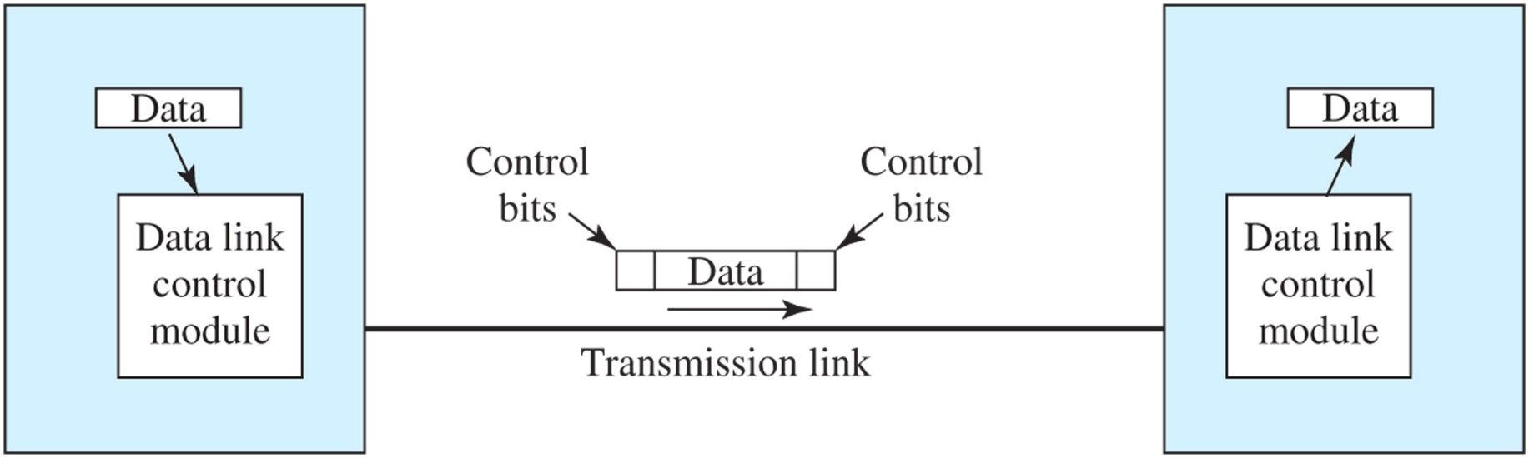
Data Link Control Module
Data Link control protocol regulates the flow of data
Frame is supplemented with control bits to allow reliable data delivery

Slide 3
Flow Control
Necessary when data is being sent faster than it can be processed by receiver
Prevents buffers from overflowing
Computer to printer is typical setting
Can also be from computer to computer, when a processing program is limited in capacity

Slide 4
Error Control
Two types of errors
  Lost frame
  Damaged frame
Automatic Repeat reQuest (ARQ)
  Error detection
  Positive acknowledgment
  Retransmission after time-out
  Negative acknowledgment and retransmission

Slide 5
High-Level Data Link Control
On transmitting side, HDLC receives data from an application, and delivers it to the receiver on the other side of the link
On the receiving side, HDLC accepts the data and delivers it to the higher level application layer
Both modules exchange control information, encoded into a frame

Slide 6
HDLC Frame Structure
Flag: Used for synchronization. 01111110, at start and end
Address: secondary station (for multidrop configurations)
Information: the data to be transmitted
Frame check sequence: 16- or 32-bit CRC
Control: purpose or function of frame
  Information frames: contain user data
  Supervisory frames: flow/error control (ACK/ARQ)
  Unnumbered frames: variety of control functions

Slide 7
HDLC Operation
Initialization: S-frames specify mode and sequence numbers, U-frames acknowledge
Data Transfer: I-frames exchange user data, S-frames acknowledge and provide flow/error control
Disconnect: U-frames initiate and acknowledge

Slide 8
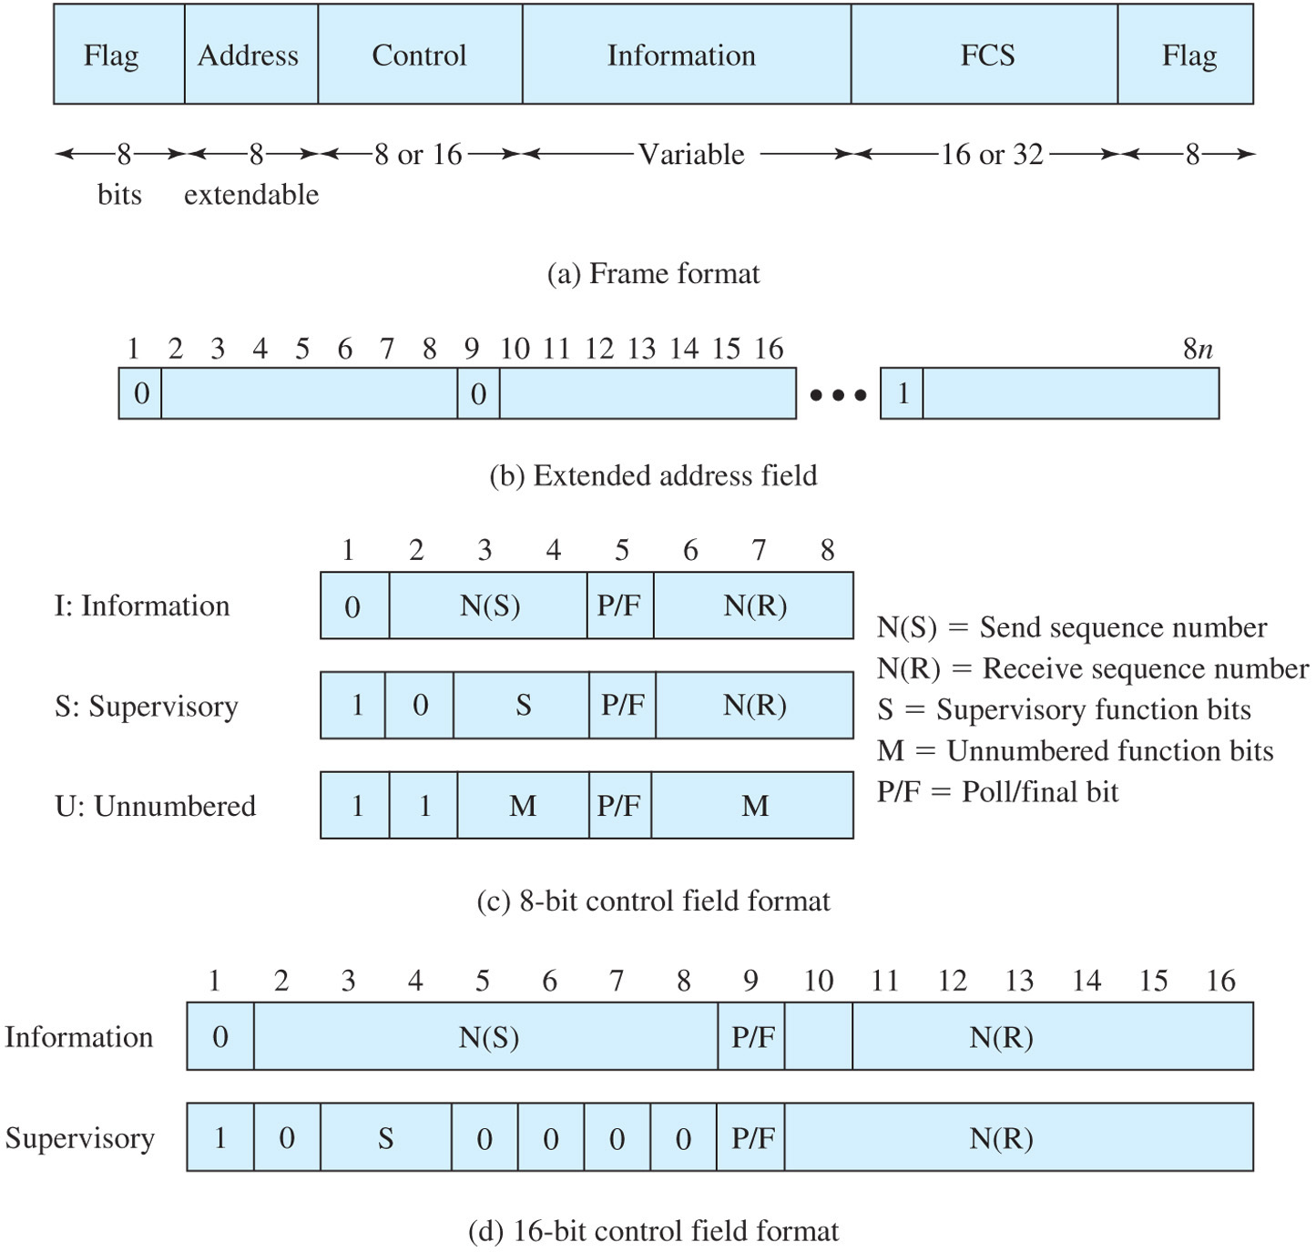
HDLC Frame Structure

Slide 9
HDLC Initialization
Signals the other side that initialization is requested
Specifies which of three modes is requested (primary or peer connection)
Specifies whether 3 or 7-bit sequence numbers are used

Slide 10
HDLC Data Transfer
Data is transmitted in I frames; starting with sequence number 0.
N(S) and N(R) fields are sequence numbers that support flow control and error control.
S frames are also used for flow control and error control.

Slide 11
HDLC Disconnect
HDLC issues a disconnect by sending a Disconnect (DISC) frame.
The other side acknowledges the disconnect by replying with a UA.

Slide 12
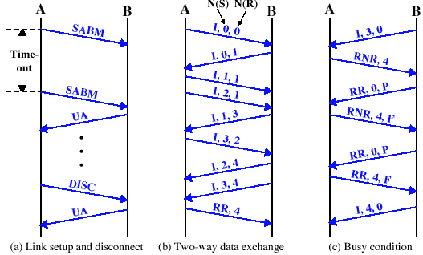
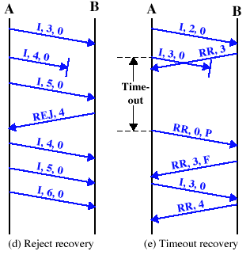
HDLC Examples

Slide 13
Multiplexing
Shared use of communication capacity
Commonly used in long-haul communications, on high-capacity fiber, coaxial, or microwave links
Multiplexer combines data from n input lines and transmits over a higher-capacity data link
Demultiplexer accepts multiplexed data stream, separates the data according to channel, and delivers them to the appropriate output lines.

Slide 14
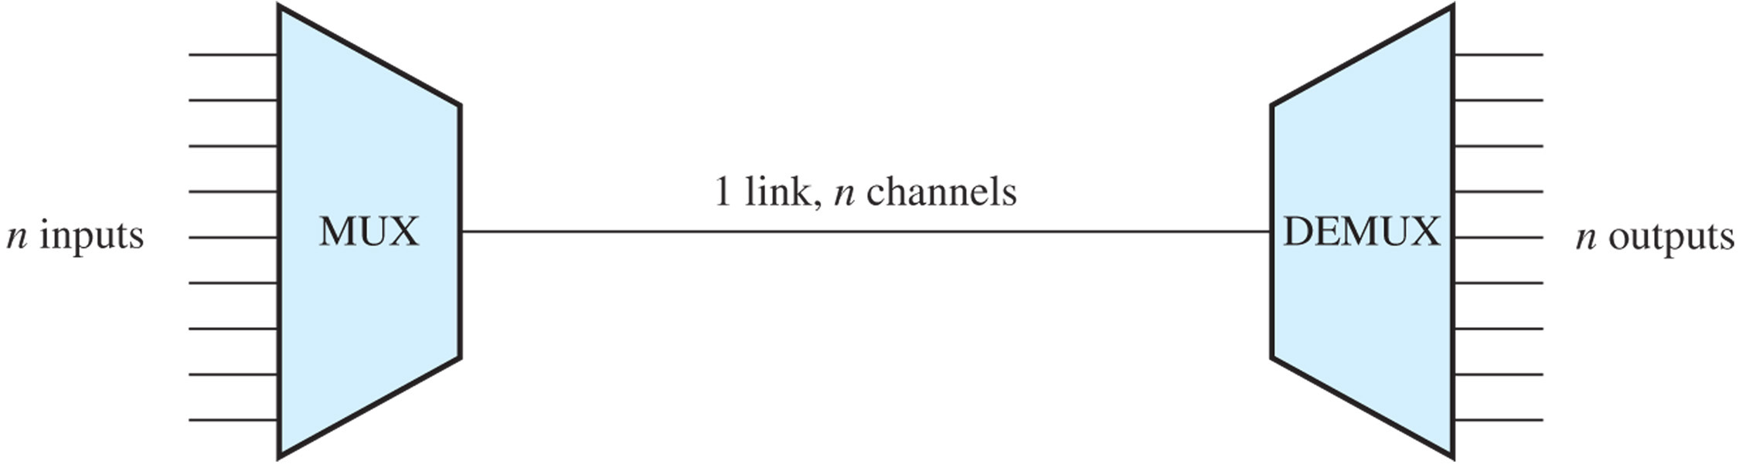
Multiplexing

Slide 15
Motivations for Multiplexing
The higher the data rate, the more cost-effective the transmission facility
  cost per kbps declines with an increase in the data rate of the transmission facility
  cost of transmission and receiving equipment, per kbps, declines with increasing data rate.
Most individual data communicating devices require relatively modest data rate support

Slide 16
Frequency Division Multiplexing (FDM)
Requires analog signaling & transmission
Total bandwidth = sum of input bandwidths + guardbands
Modulates signals so that each occupies a different frequency band
Standard for radio broadcasting, analog telephone network, and television (broadcast, cable, & satellite)

Slide 17
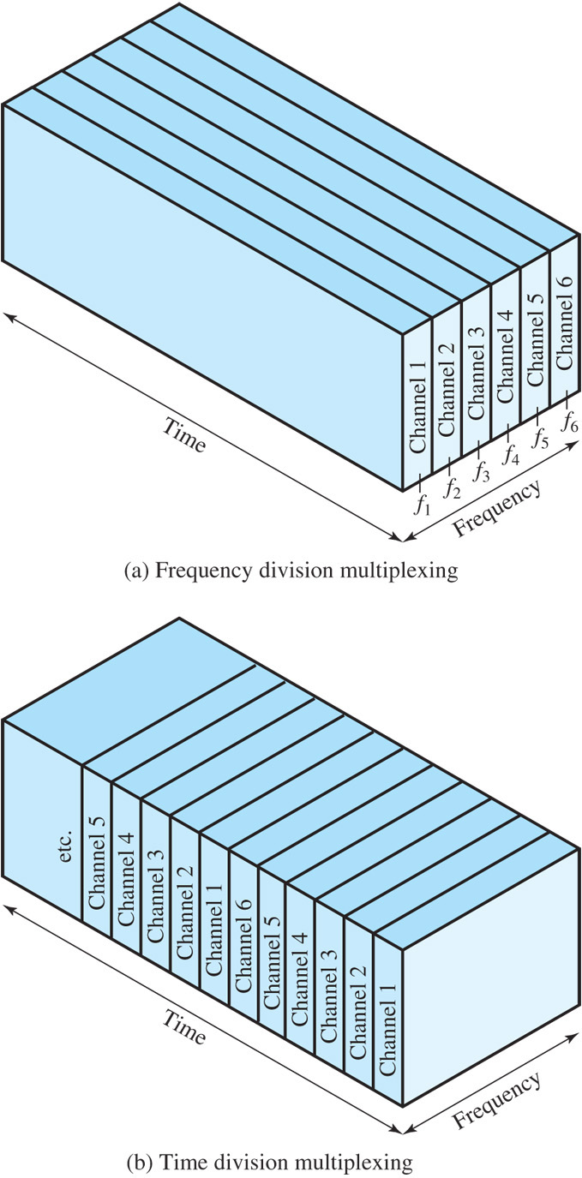
FDM and TDM

Slide 18
Wavelength Division Multiplexing
Form of FDM used when multiple beams of light at different frequencies are transmitted on the same optical fiber.
Uses the same architecture as FDM
Most WDM systems operate in the 1550-nm range. In early systems, 200 MHz was allocated to each channel, but today most WDM systems use 50-GHz spacing
dense wavelength division multiplexing (DWDM) connotes the use of more channels, more closely spaced (≤200Ghz), than ordinary WDM

Slide 19
FDM Example: ADSL
ADSL uses frequency-division modulation (FDM) to exploit the 1-MHz capacity of twisted pair.
Asymmetric because ADSL provides more capacity downstream (from the carrier’s central office to the customer’s site) than upstream (from customer to carrier).

Slide 20
3 Elements of ADSL Strategy
Reserve lowest 25 kHz for voice, known as POTS
Use echo cancellation or FDM to allocate a small upstream band and a larger downstream band
Use FDM within the upstream and downstream bands, using “discrete multitone”

Slide 21
Echo Cancellation
Entire frequency band for the upstream channel overlaps the lower portion of the downstream channel
Advantages
  The higher the frequency, the greater the attenuation.
  More flexible for changing upstream capacity
Disdvantages
  Need for echo cancellation logic on both ends of line

Slide 22
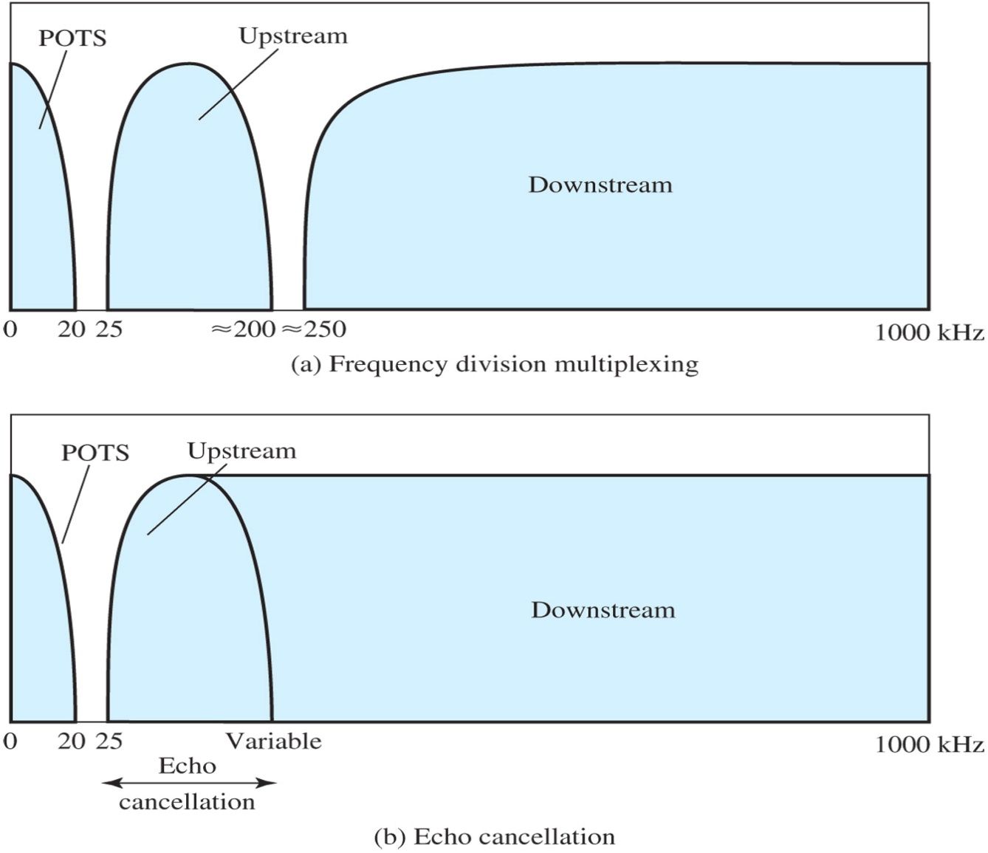
ADSL Channel Configuration

Slide 23
Discrete Multitone (DMT)
Uses multiple carrier signals at different frequencies, sending some of the bits on each channel.
Transmission band (upstream or downstream) is divided into a number of 4-kHz subchannels.
Modem sends out test signals on each subchannel to determine the signal to noise ratio; it then assigns more bits to better quality channels and fewer bits to poorer quality channels.

Slide 24
Synchronous Time-Division Multiplexing (TDM)
Used in digital transmission
Requires data rate of the medium to exceed data rate of signals to be transmitted
Signals “take turns” over medium
Slices of data are organized into frames
Time slots are pre-assigned to sources and are fixed
Time slots are transmitted regardless of data
Used in the modern digital telephone system
  US, Canada, Japan: DS-0, DS-1 (T-1), DS-3 (T-3), ...
  Europe, elsewhere: E-1, E3, …

Slide 25
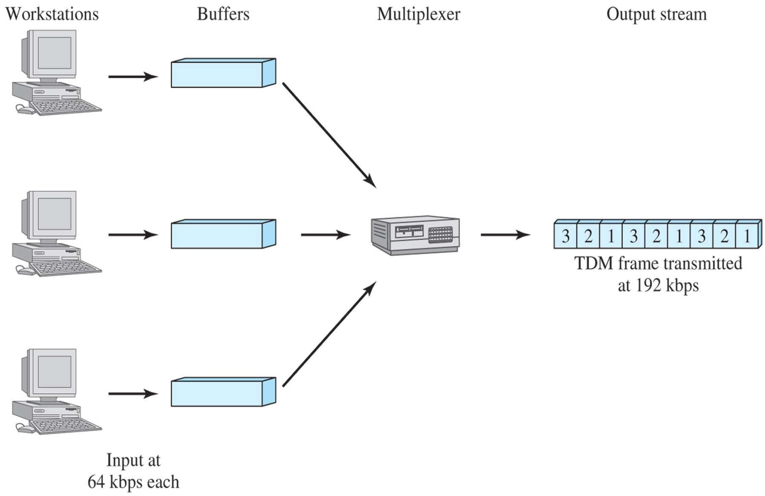
Synchronous TDM Example

Slide 26
Digital Carrier Systems
Long-distance carrier system designed to transmit voice signals over high-capacity transmission links (e.g. optical fiber, coaxial cable, and microwave)
Evolution of these networks to digital involved adoption of synchronous TDM transmission structures

Slide 27
DS-1 Transmission Format
Multiplexes 24 channels
Voice transmission
  Frame contains 8 bits per channel plus a framing bit for 24 × 8 + 1 = 193 bits
  Signal digitized with PCM at 8000 samples/second
  Data rate of 8000 × 193 = 1.544 Mbps
Data transmission
  23 channels of data are provided
  Last channel position reserved for special sync byte
Mixed voice and data uses all 24 channels

Slide 28
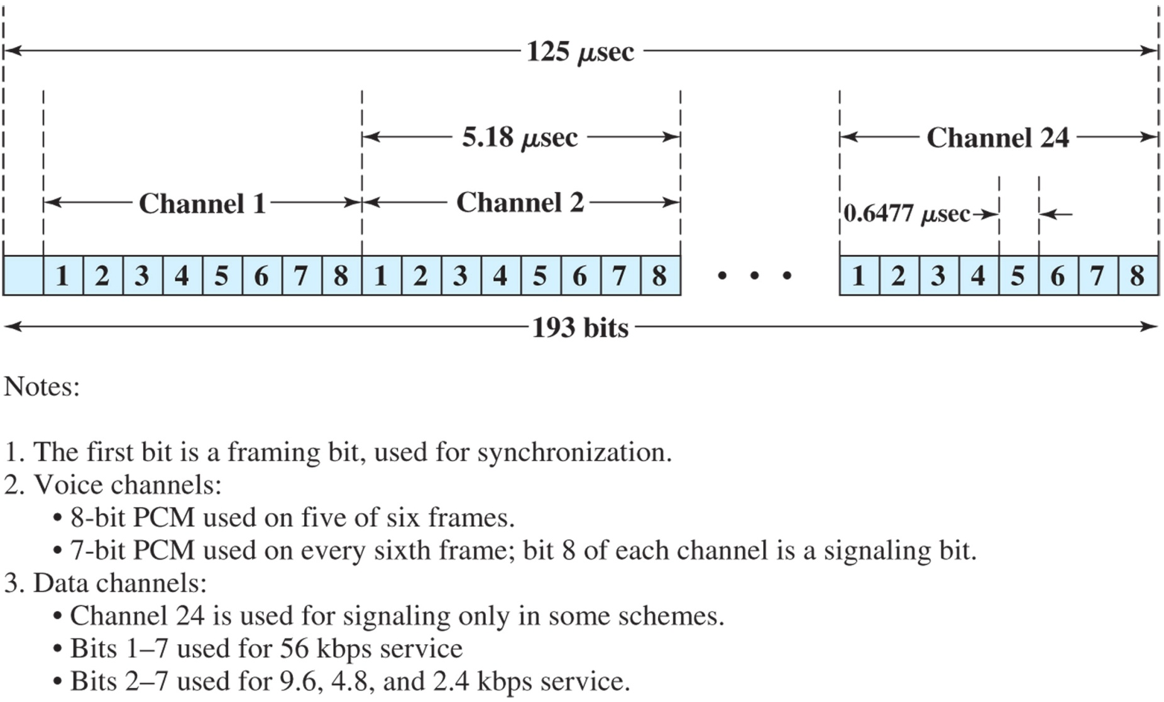
DS-1 Transmission Format

Slide 29
T-1 Facilities
Transmission facilities supporting DS-1
Often used for leased dedicated transmission between customer premises
  Private voice networks
  Private data network
  Video teleconferencing
  High-speed digital facsimile
  Internet access

Slide 30
SONET/SDH
SONET (Synchronous Optical Network) is an optical transmission interface proposed by BellCore and standardized by ANSI.
Synchronous Digital Hierarchy (SDH), a compatible version, has been published by ITU-T
Specifications for taking advantage of the high-speed digital transmission capability of optical fiber.

Slide 31
SONET/SDH Features
Defined hierarchy of standardized digital data rates
The lowest level is 51.84 Mbps
Basic building block is the STS-1 frame; which can be viewed as a matrix of 9 rows of 90 octets; the first 3 columns are overhead octets, the remainder is payload

Slide 32
SONET/SDH Signal Hierarchy

Slide 33
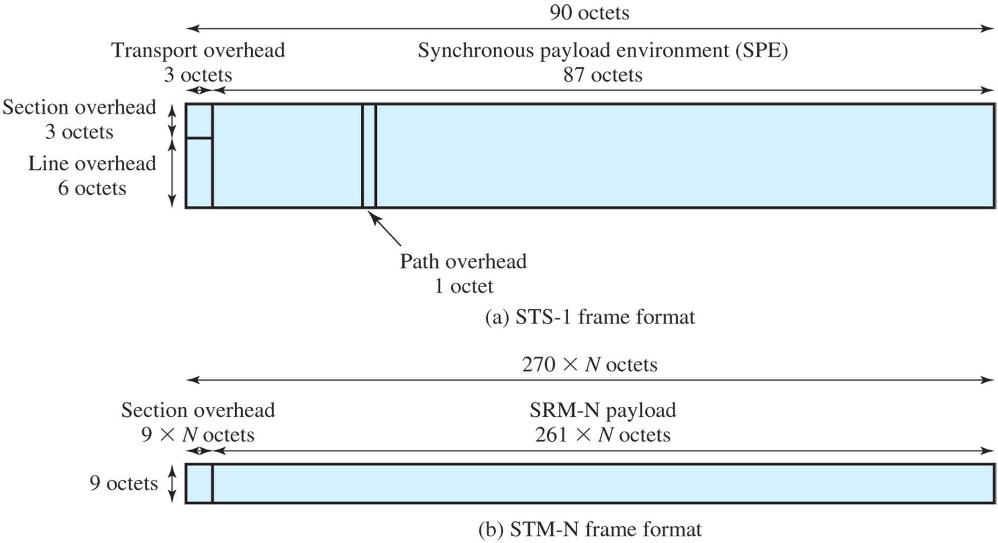
SONET/SDH Frame Formats

