Slide 1
Chapter 13:
Frame Relay & ATM
Business Data Communications, 6e

Slide 2
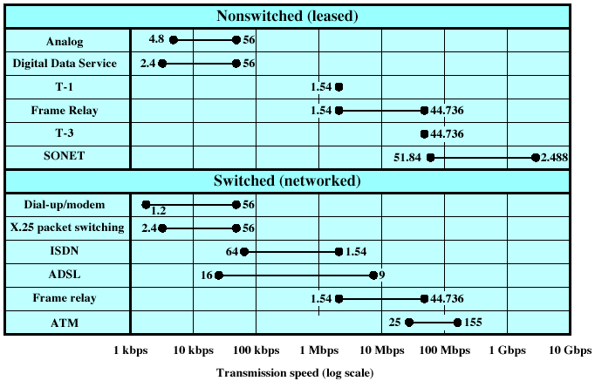
WAN Alternatives

Slide 3
WAN Alternatives
Service | Usage Rate | Distance Rate
Leased line | Fixed price per month for a specific capacity (T-1 or T-3) and no additional fee for usage | More for greater distance.
ISDN | Fixed price per month for service plus a usage charge based on amount of connect time. | Long-distance charges apply.
Frame relay | Fixed price per month for a port connection and a flat rate for a permanent virtual circuit (PVC) based on the capacity of the link. | Not Distance sensitive.
ATM | Pricing policies vary. | Not Distance sensitive.

Slide 4
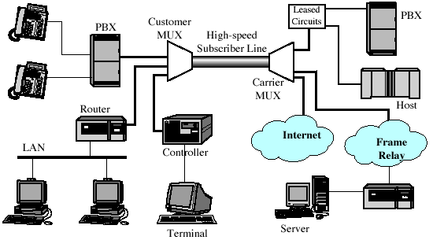
Integrated Network Access
Using Dedicated Channels

Slide 5
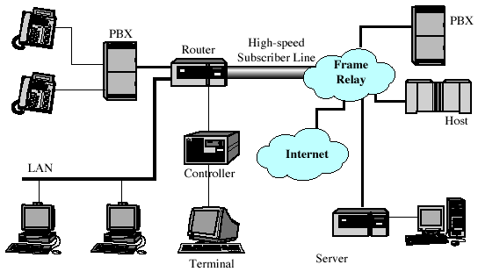
Integrated Network Access
Using Public Switched WAN

Slide 6
X.25 Key Features
Call control packets carried on the same channel and same virtual circuit as data packets.
Multiplexing of virtual circuits takes place at layer 3.
Both layer 2 & 3 include flow and error control mechanisms

Slide 7
Frame Relay Key Features
Designed to be more efficient than packet switching
Designed to eliminate excessive X.25 overhead
Call control signalingis on a separate logical connection from user data.
Multiplexing and switching of logical connections takes place at layer 2.
No hop-by-hop flow control and error control.

Slide 8
Frame Relay Characteristics
Control signaling takes place on a separate logical connection (nodes don’t need state tables for each call)
Multiplexing/switching take place at layer 2, eliminating a layer of processing
No hop-by-hop flow/error control

Slide 9
Frame Relay vs. X.25
Reliability
  Frame relay loses ability to do link-by-link flow and error control.
  X.25 link level protocol provides reliable hop-by-hop link control
  With increasing reliability of transmission and switching facilities, this is not a major disadvantage.
Streamlining
  Frame relay reduces need for protocol functionality at the user-network interface, and reduces internal network processing
  Improvement in throughput using frame relay, compared to X.25, of an order of magnitude or more

Slide 10
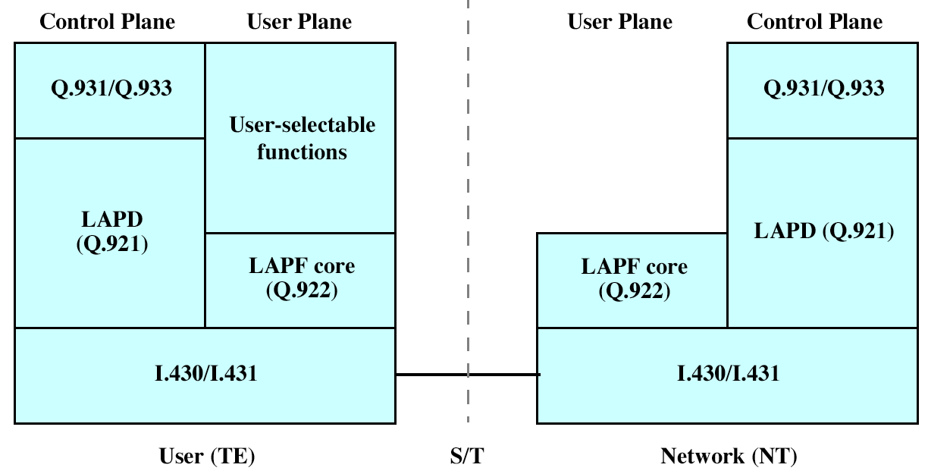
Frame Relay Architecture

Slide 11
Frame Relay Control Plane
Similar to common channel signaling, in that a separate logical channel is used for control information.
At the data link layer, LAPD (Q.921) provides a reliable data link control service, with error control and flow control, between user (TE) and network (NT).
This data link service is used for the exchange of Q.933 control signaling messages.

Slide 12
Frame Relay User Plane
User-plane protocol is LAPF (Link Access Procedure for Frame Mode Bearer Services), defined in Q.922
Core functions of LAPF are used for frame relay:
  Frame delimiting, alignment, and transparency
  Frame multiplexing/demultiplexing using address field
  Inspection of frame contents
  Inspection of the frame to ensure that it is neither too long nor too short
  Detection of transmission errors
  Congestion control functions

Slide 13
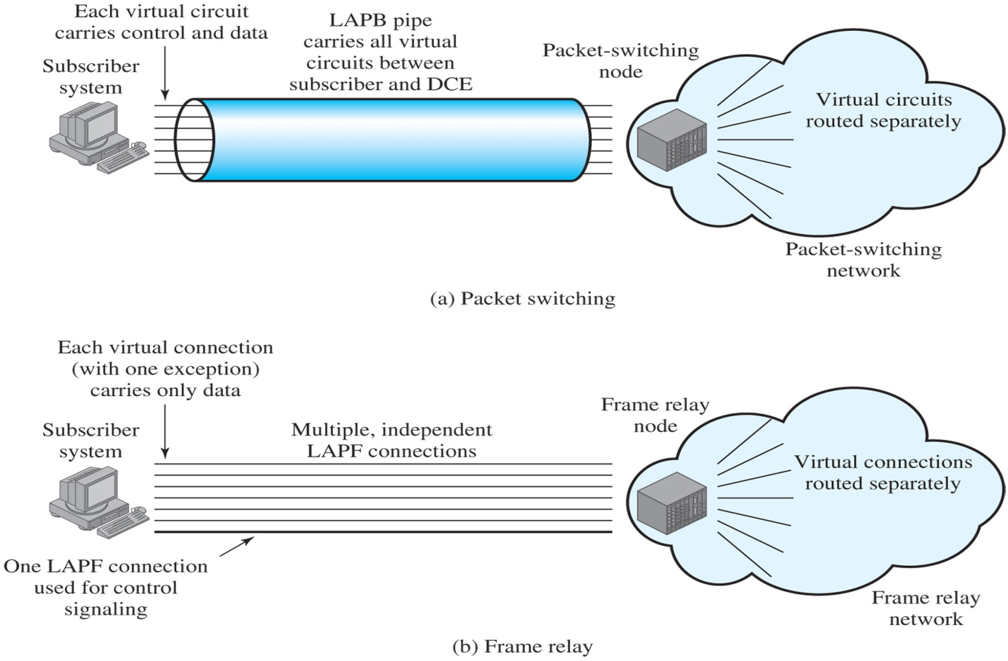
Frame Relay Virtual Connections

Slide 14
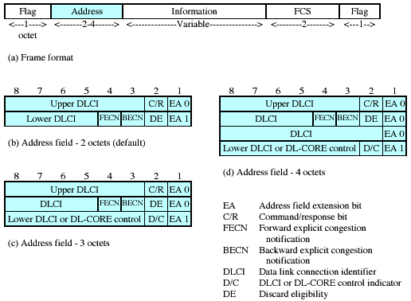
LAPF-Core Formats

Slide 15
User Data Transfer
No control field; connection mgt must be carried out on a separate channel, and there is no flow or error control
Flag and frame check sequence (FCS) fields function as in HDLC.
Information field carries higher-layer data
Address field length determined by the address field extension (EA) bits

Slide 16
Frame Relay Call Control
Establish a logical connection between two endpoints, and assign a unique DLCI to the connection
Exchange information in data frames. Each frame includes a DLCI field to identify the connection
Release the logical connection

Slide 17
Frame Relay Congestion Control
Two strategies supported in frame relay
  Congestion avoidance procedures are used at the onset of congestion to minimize the effect on the network
  Congestion recovery procedures are used to prevent network collapse in the face of severe congestion

Slide 18
Congestion Notification Bits
Backward Explicit Congestion Notification (BECN): Indicates that the frame that the user transmits on this logical connection may encounter congested resources.
Forward Explicit Congestion Notification (FECN): Indicates that the frame has encountered congested resources.

Slide 19
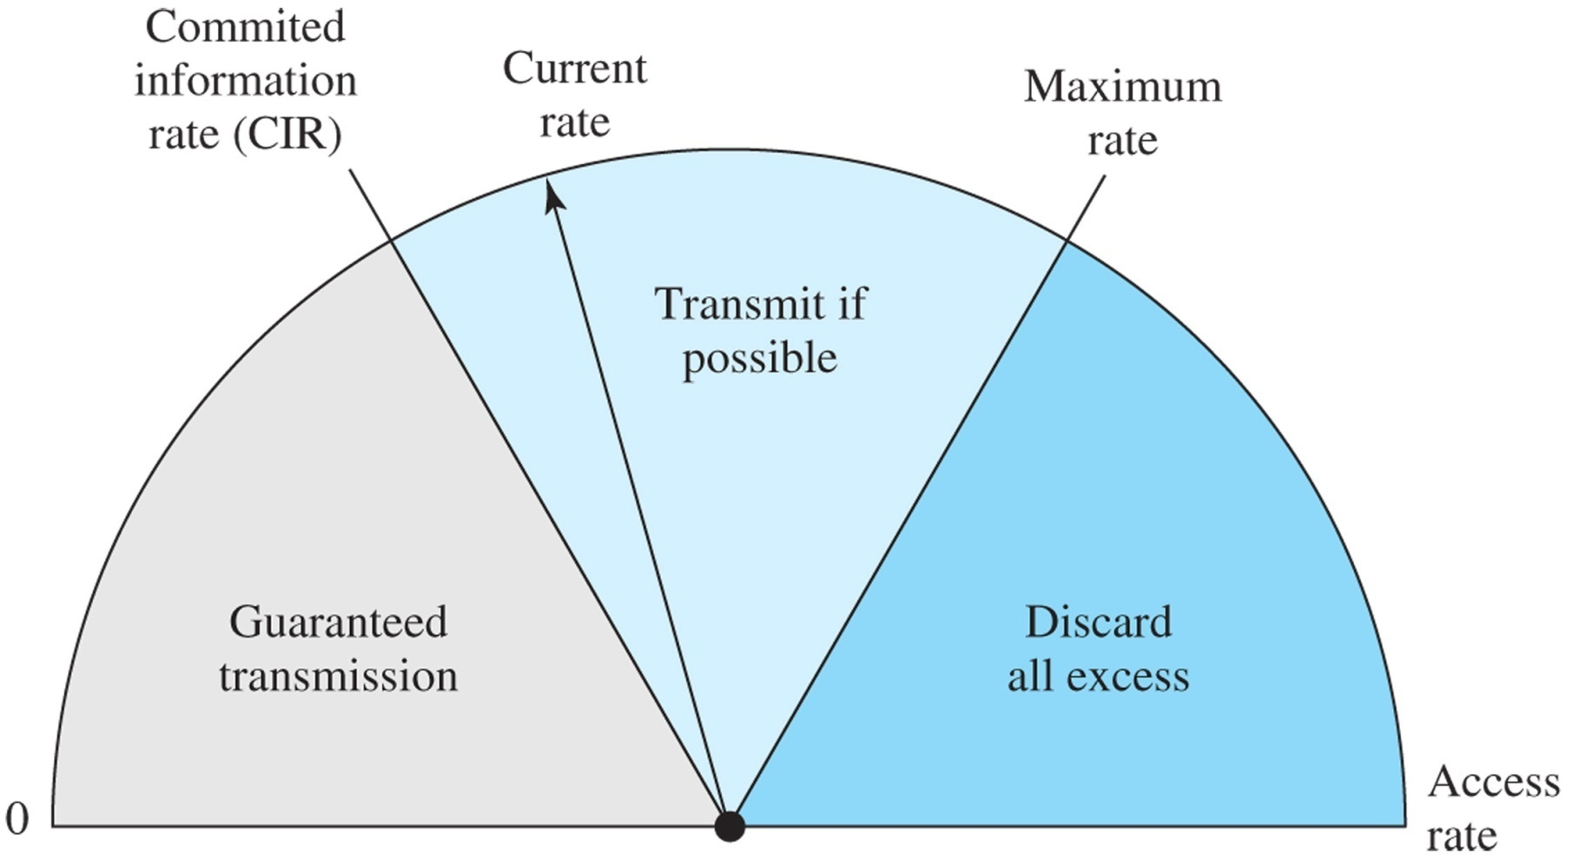
Operation of the CIR

Slide 20
Asynchronous Transfer Mode (ATM)
Also known as cell relay
Faster than X.25, more streamlined than frame relay
Supports data rates several orders of magnitude greater than frame relay
Data on logical connection is organized into fixed-size packets, called cells.
No link-by-link error control or flow control.

Slide 21
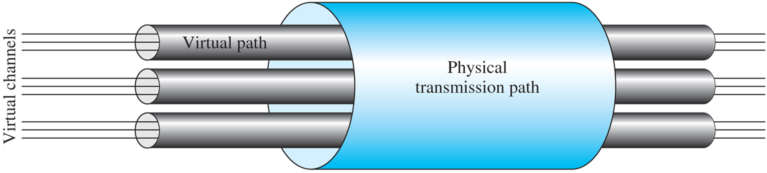
ATM Connection Relationships

Slide 22
Virtual Channels & Virtual Paths
Logical connections in ATM are virtual channels
  analogous to a virtual circuit in X.25 or a frame relay logical connection
  used for connections between two end users, user-network exchange (control signaling), and network-network exchange (network management and routing)
  Variable rate, full duplex flow is exchanged
A virtual path is a bundle of virtual channels that have the same endpoints.

Slide 23
Advantages of Virtual Paths
Simplified network architecture
Increased network performance and reliability
Reduced processing and short connection setup time
Enhanced network services

Slide 24
Virtual-Path/Virtual-Channel Characteristics
Quality of service
Switched and semi-permanent virtual-channel connections
Cell sequence integrity
Traffic parameter negotiation and usage monitoring

Slide 25
ATM Control Signaling:
Virtual Paths
Semipermanent virtual channels may be used for user-to-user exchange; no control signaling is required.
Meta-signaling channel, a permanent low-data-rate channel used for a virtual channel that can be used for call control
  user-to-network signaling virtual channel can than be used to set up virtual channels to carry user data
  can also be used to set up a user-to-user signaling virtual channel within a preestablished virtual path

Slide 26
ATM Control Signaling:
Virtual Paths
A virtual path can be established on a semipermanent basis by prior agreement. No control signaling is required.
Establishment/release may be customer controlled. Customer uses a signaling virtual channel to request the virtual path from the network.
Establishment/release may be network controlled. Network establishes a virtual path (may be network-to-network, user-to-network, or user-to-user)

Slide 27
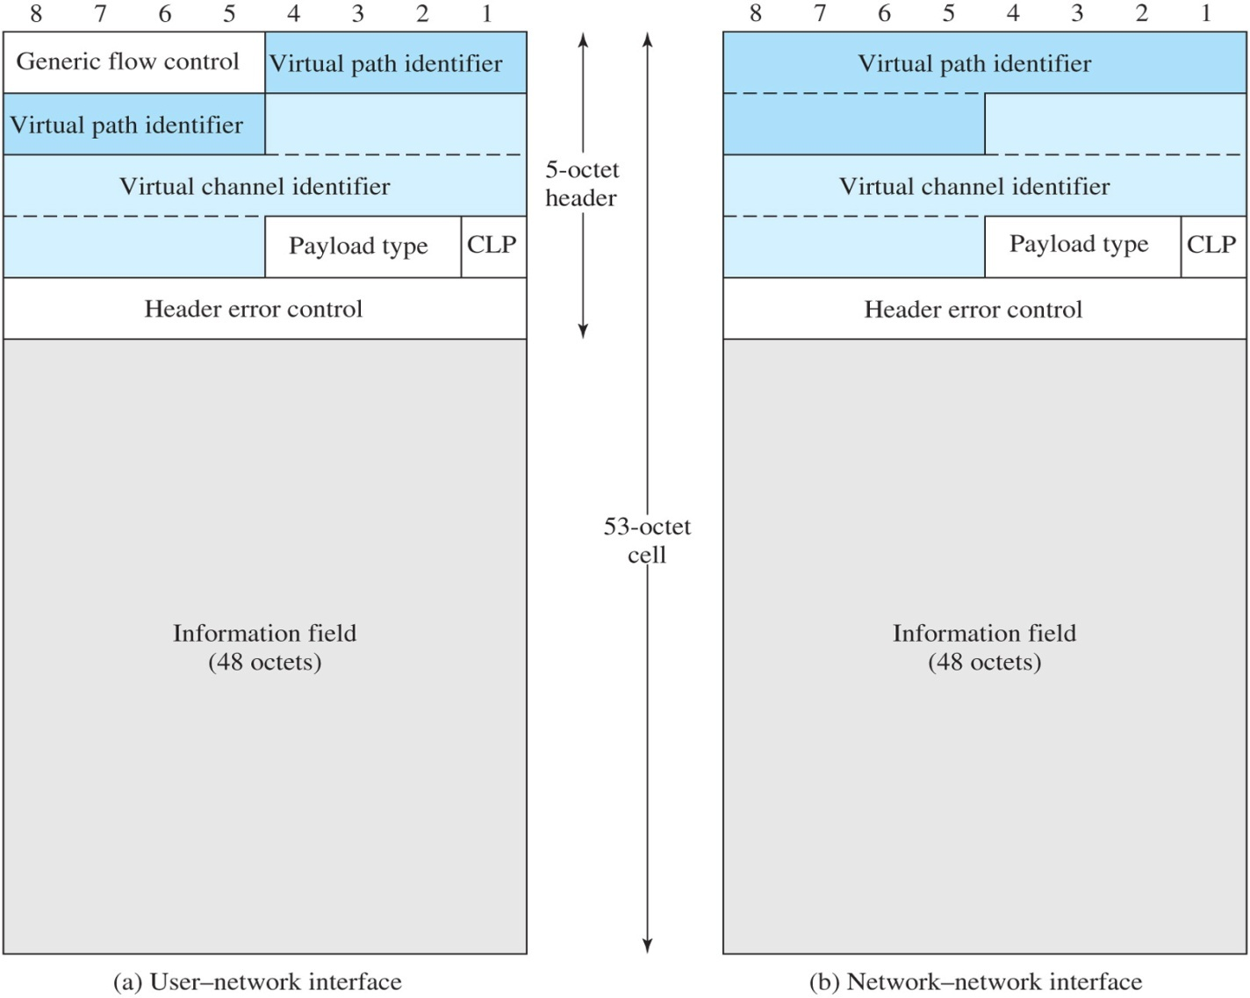
ATM Cell Format

Slide 28
ATM Cell Fields
Generic Flow Control (GFC) is used for control of cell flow only at the local user-network interface, to alleviate short-term overload conditions in the network.
Virtual Path Identifier (VPI) field constitutes a routing field for the network.
Virtual Channel Identifier (VCI) field is used for routing to and from the end user.
Payload Type (PT) field indicates the type of information in the information field.
Cell loss priority (CLP) bit is used to provide guidance to the network in the event of congestion.
Header Error Control (HEC) field is used to correct and detect errors in the header

Slide 29
ATM Service Categories
Real-Time Service
  Constant bit rate (CBR)
  Real-time variable bit rate (rt-VBR)
Non-Real-Time Service
  Non-real-time variable bit rate (nrt-VBR)
  Available bit rate (ABR)
  Unspecified bit rate (UBR)
  Guaranteed frame rate (GFR)

Slide 30
Real Time Service
Constant Bit Rate (CBR)
- simplest service to define
- used by applications that require a fixed, continuously available data rate
- commonly used for uncompressed audio and video

Slide 31
Real Time Service
Real-Time Variable Bit Rate (rt-VBR)
- intended for time sensitive applications
- transmits at a rate that varies with time
- can be bursty

Slide 32
Non-Real Time Services
Non-Real Time Variable Bit Rate (nrt-VBR)
-end system specifies a peak cell rate, sustainable cell rate and how bursty the cells may be
- network allocates resources to provide low delay and minimal cell loss

Slide 33
Non-Real Time Services
Unspecified Bit Rate (UBR)
-suitable for TCP based traffic
-cells are forwarded on a FIFO basis
-delays and variable losses are possible
-used for text/image/data transfer, messaging, distribution, retrieval and remote terminal

Slide 34
Non-Real Time Services
Available Bit Rate (ABR)
-specifies a peak and minimum cell rate
-network resources are allocated to at least the minimum level
-used for LAN interconnections

Slide 35
Non-Real Time Services
Guaranteed Frame Rate (GFR)
-designed to support IP backbone subnetworks.
-seeks to optimize frame-based traffic from a LAN through a router onto an ATM backbone

