Slide 1
Chapter 10:
Ethernet
Business Data Communications, 6e

Slide 2
Approaches to High-Speed LAN Design
Fast Ethernet and Gigabit Ethernet
Fibre Channel
High-speed Wireless LANs

Slide 3
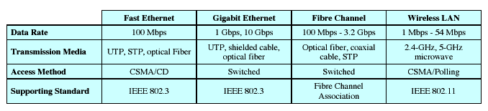
Characteristics of
Some High-Speed LANS

Slide 4
Traditional Ethernet
Ethernet and CSMA/CD (IEEE 802.3)
Carrier sense multiple access with collision detection
Four step procedure
  If medium is idle, transmit
  If medium is busy, listen until idle and then transmit
  If collision is detected, cease transmitting
  After a collision, wait a random amount of time before retransmitting

Slide 5
Bus Topology
All stations attach through a tap
Supports full duplex
A transmission can be received by all stations
Data is transmitted in frames

Slide 6
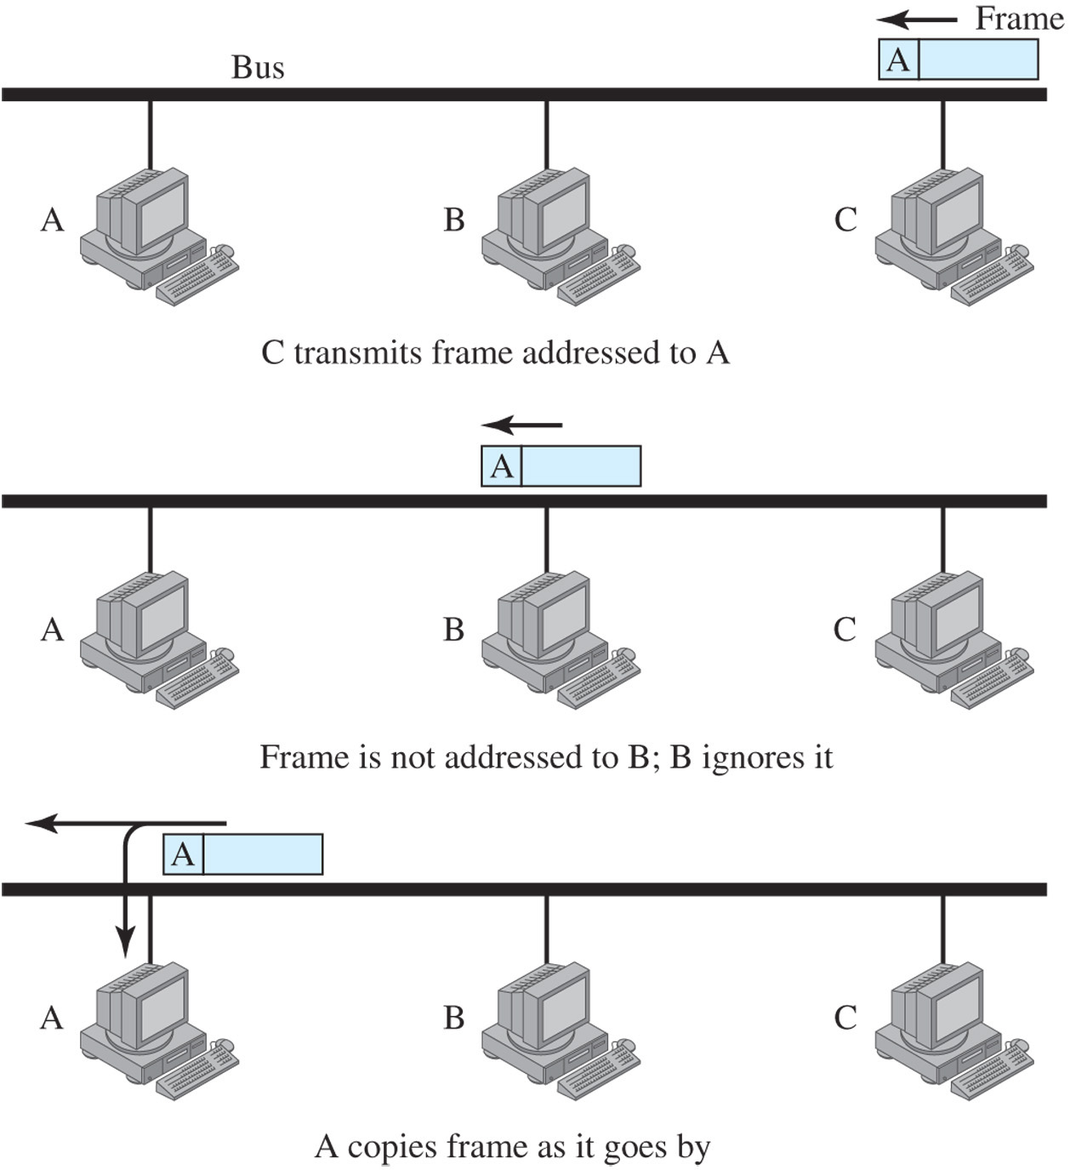
Frame Transmission on a Bus LAN

Slide 7
Ethernet MAC Frame Format
Preamble: 7-octet pattern of 0s &1s used to establish bit synchronization.
Start Frame Delimiter (SFD): Indicates actual start of frame.
Destination Address (DA): Specifies the station(s) for which the frame is intended
Source Address (SA): Specifies the station that sent the frame.
Length: Length of LLC data field in octets.
LLC Data: Data unit supplied by LLC.
Pad: Octets added to ensure that the frame is long enough for proper CD operation.
Frame Check Sequence (FCS): A 32-bit CRC, based on all fields except preamble, SFD, and FCS.

Slide 8
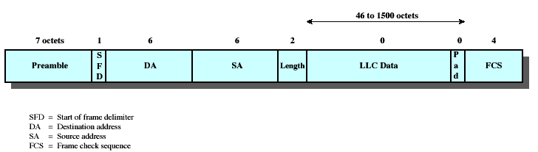
Ethernet MAC Frame

Slide 9
802.3 Medium Notation
Notation format:
<data rate in Mbps><signaling method><maximum segment length in hundreds of meters>
e.g 10Base5 provides 10Mbps baseband, up to 500 meters
T and F are used in place of segment length for twisted pair and fiber

Slide 10
802.3 10BaseX Media Options

Slide 11
Bridges
Allow connections between LANs and to WANs
Used between networks using identical
physical and link layer protocols
Provide a number of advantages
  Reliability: Creates self-contained units
  Performance: Less contention
  Security: Not all data broadcast to all users
  Geography: Allows long-distance links

Slide 12
Bridge Functions
Read all frames from each network
Accept frames from sender on one network that are addressed to a receiver on the other network
Retransmit frames from sender using MAC protocol for receiver
Must have some routing information stored in order to know which frames to pass

Slide 13
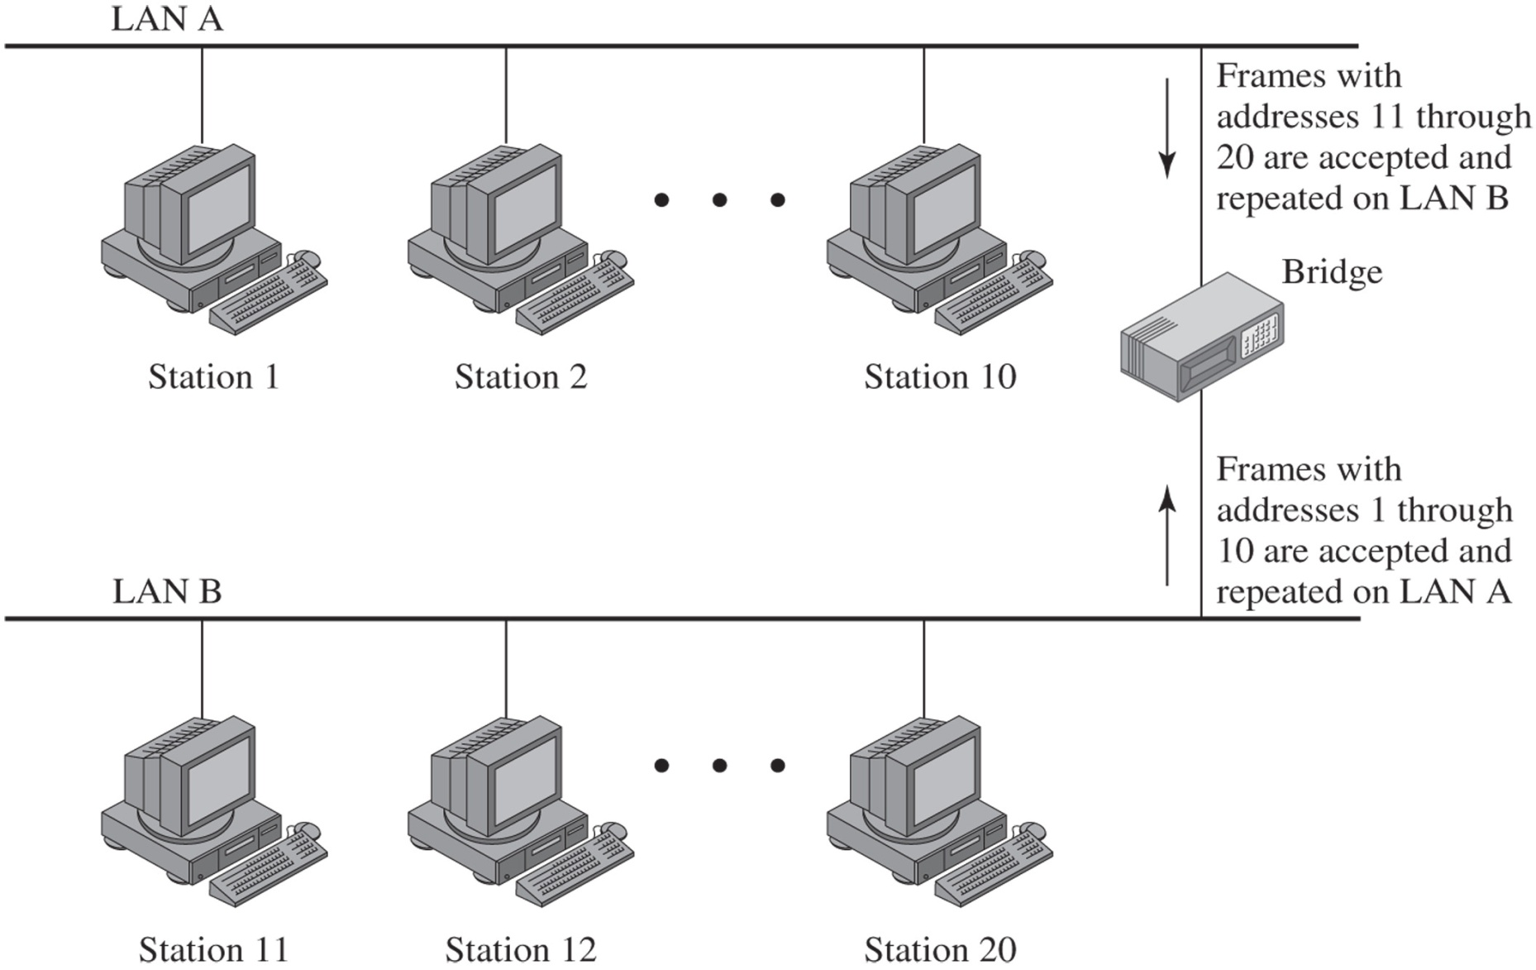
Bridge Operation

Slide 14
Key Aspects of Bridge Function
Makes no modification to content or format of frames it receives; simply copies from one LAN and repeats with exactly the same bit pattern as the other LAN.
Should contain enough buffer space to meet peak demands.
Must contain addressing and routing intelligence.
May connect more than two LANs.

Slide 15
Hubs
Alternative to bus topology
Each station is connected to the hub by two lines (transmit and receive)
When a single station transmits, the hub repeats the signal on the outgoing line to each station.
Physically a star; logically a bus.
Hubs can be cascaded in a hierarchical configuration.

Slide 16
Two-Level Star Topology

Slide 17
Layer 2 Switches
Also called a “switching hub”
Has replaced hub in popularity, particularly for high-speed LANs
Provides greater performance than a hub
Incoming frame from a particular station is switched to the appropriate output line to be delivered to the intended destination
At the same time, other unused lines can be used for switching other traffic

Slide 18
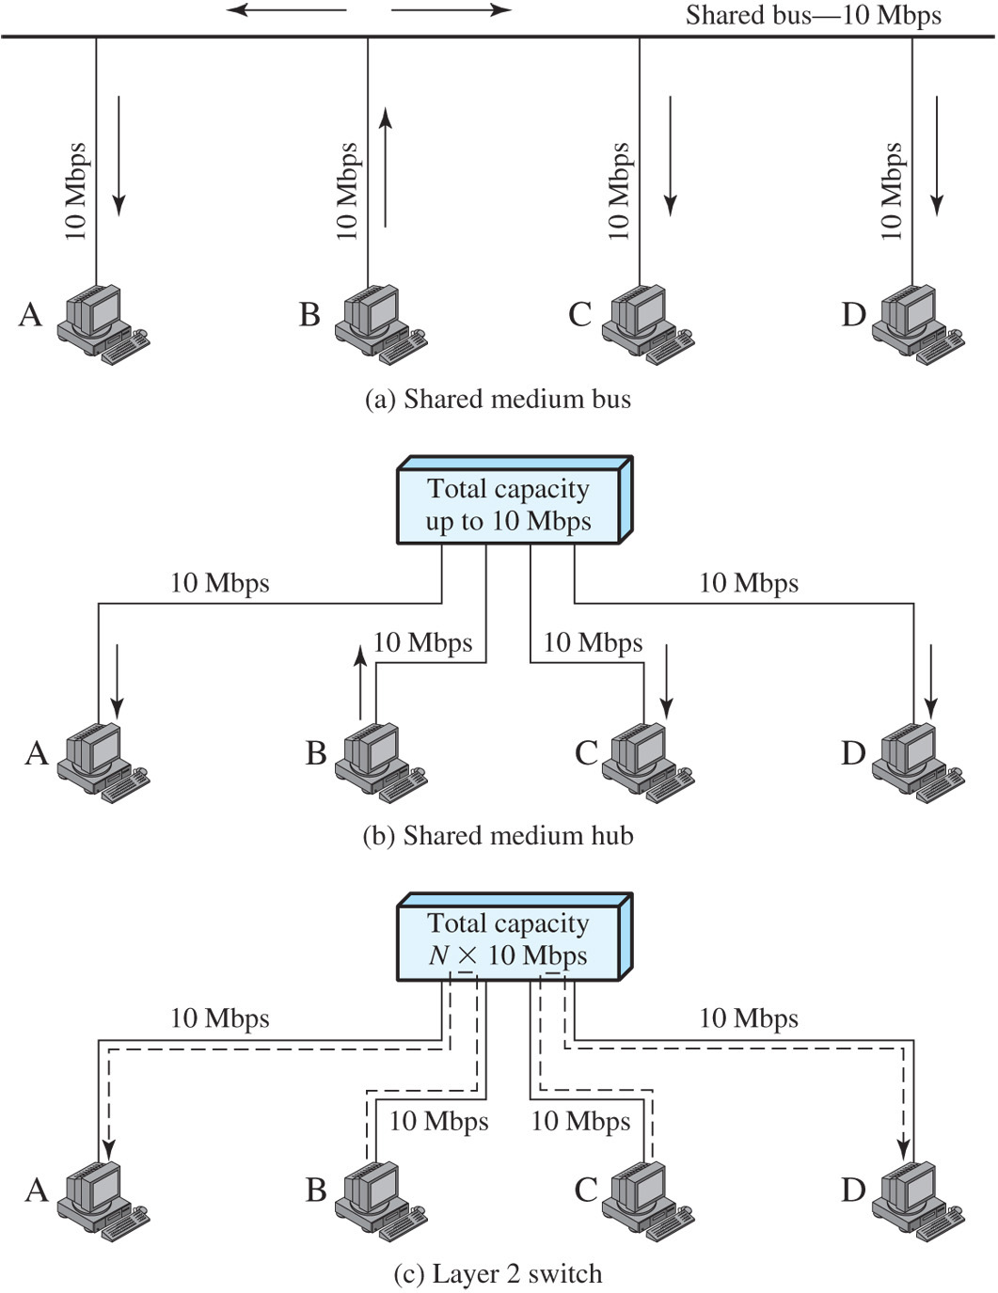
LAN Hubs and Switches

Slide 19
Advantages of Switched Hubs
No modifications needed to workstations when replacing shared-medium hub
Each device has a dedicated capacity equivalent to entire LAN
Easy to attach additional devices to the network

Slide 20
Types of Switched Hubs
Store and forward switch
  Accepts a frame on input line
  Buffers it briefly
  Routes it to appropriate output line
Cut-through switch
  Begins repeating the frame as soon as it recognizes the destination MAC address
  Higher throughput, increased chance of error

Slide 21
Differences Between
Switched Hubs and Bridges
Bridge frame handling is done in software. A layer 2 switch performs the address recognition and frame forwarding functions in hardware.
Bridges typically only analyze and forward one frame at a time; a layer 2 switch can handle multiple frames at a time.
Bridges uses store-and-forward operation; layer 2 switches use cut-through instead of store-and-forward operation
New installations typically include layer 2 switches with bridge functionality rather than bridges.

Slide 22
Problems With Layer 2 Switches
Broadcast overload
Lack of multiple links
Can be solved with subnetworks connected by routers
However, high-speed LANs layer 2 switches process millions of packets per second whereas a software-based router may only be able to handle well under a million packets per second

Slide 23
Layer 3 Switches
Implement the packet-forwarding logic of the router in hardware.
Packet-by-packet switch operates like a traditional router
  Forwarding logic is in hardware
  Achieves an order of magnitude increase in performance compared to software-based routers
Flow-based switch identifies flows of IP packets that have the same source and destination
  Once flow is identified, a predefined route can be established to speed up the forwarding process
  Again, huge performance increases over a pure software-based router are achieved

Slide 24
Why Use Ethernet for
High-Speed Networks?
Negative
  CSMA/CD is not an ideal choice for high-speed LAN design due to scaling issues, but there are reasons for retaining Ethernet protocols
Positive
  Use of switched Ethernet hubs in effect eliminates collisions
  CSMA/CD protocol is well understood; vendors have experience building the hardware, firmware, and software
  Easy for customers to integrate with existing systems

Slide 25
Fast Ethernet
Refers to low-cost, Ethernet-compatible LANs operating at 100 Mbps
802.3 committee defined a number of alternatives to be used with different transmission media

Slide 26
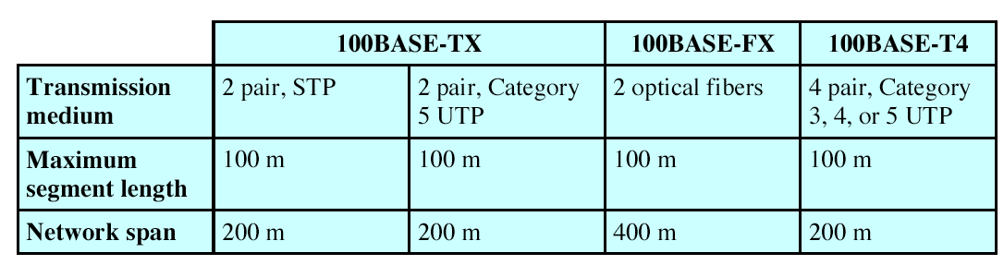
802.3 100 Mbps Physical Layer Medium Alternatives

Slide 27
Gigabit Ethernet
Retains CSMA/CD protocol and Ethernet format, ensuring smooth upgrade path
Uses optical fiber over short distances
1-gbps switching hub provides backbone connectivity

Slide 28
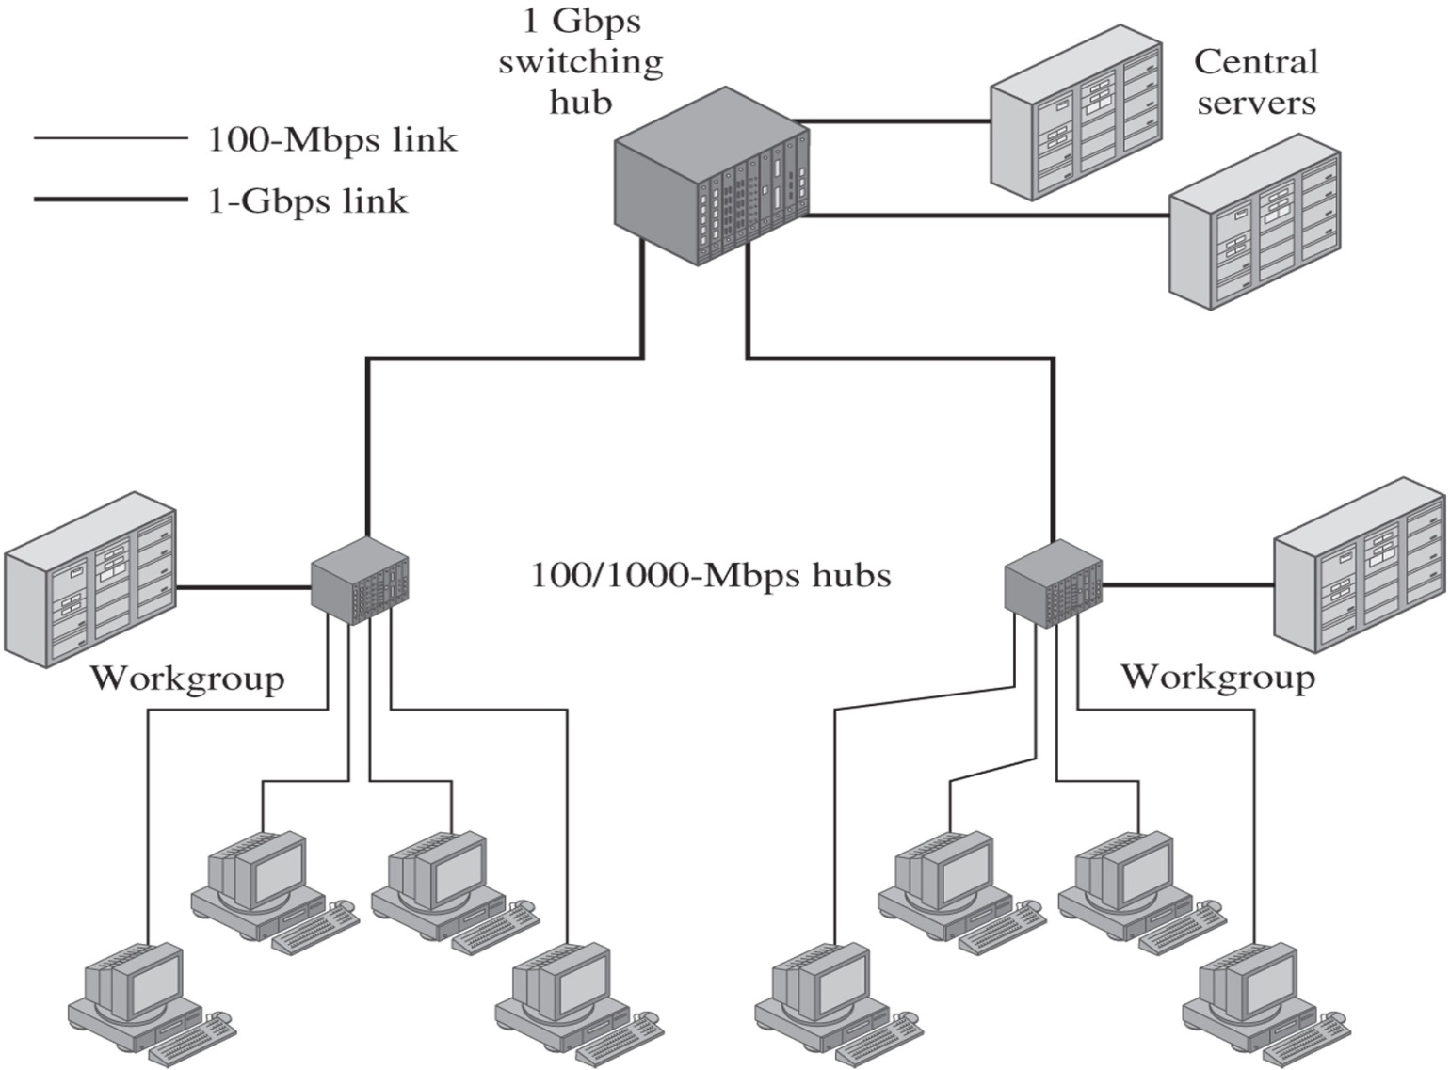
Sample Gigabit Ethernet Configuration

Slide 29
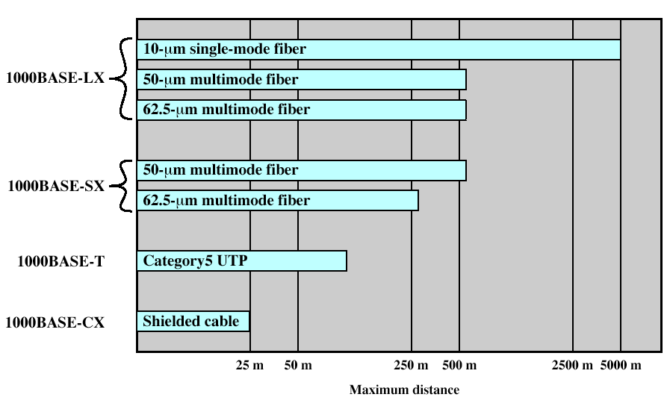
Gigabit Ethernet Media Options

Slide 30
10-Gbps Ethernet
Driven by increased network traffic
  Increased number of network connections
  Increased connection speed of each end-station (e.g., 10 Mbps users moving to 100 Mbps, analog 56k users moving to DSL and cable modems)
  Increased deployment of bandwidth-intensive applications such as high-quality video
  Increased Web hosting and application hosting traffic

Slide 31
10-Gbps Ethernet vs ATM
No expensive, bandwidth-consuming conversion between Ethernet packets and ATM cells is required
Combination of IP and Ethernet offers quality of service and traffic policing capabilities that approach those provided by ATM
A wide variety of standard optical interfaces have been specified for 10-Gbps Ethernet, optimizing its operation and cost for LAN, MAN, or WAN applications

Slide 32
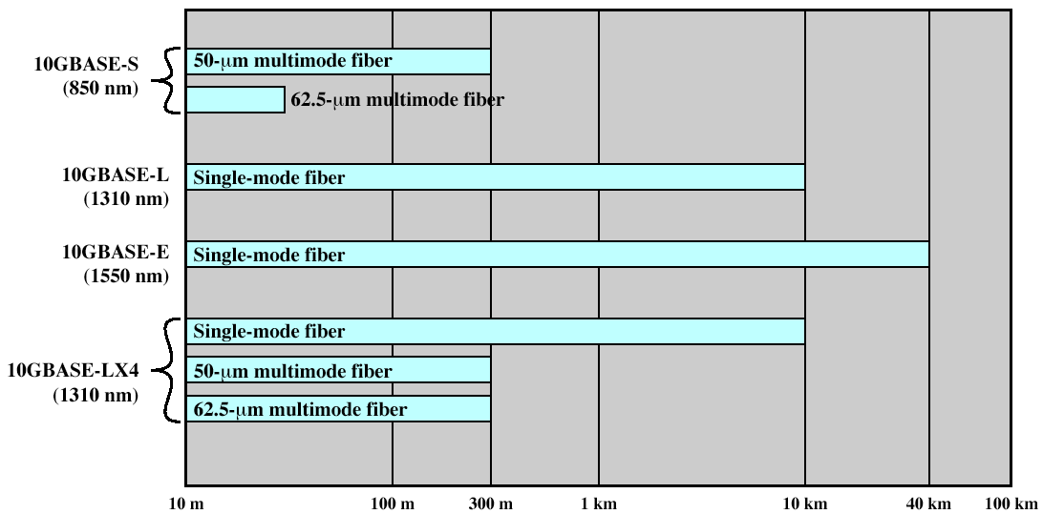
Physical Layer Options for 10-Gbps Ethernet

Slide 33
100 Gbps Ethernet Market Drivers
Data Center/Internet media providers
Metro-video/service providers
Enterpise Lans
Internet exchanges/ISP (Internet Service Provider) core routing

Slide 34
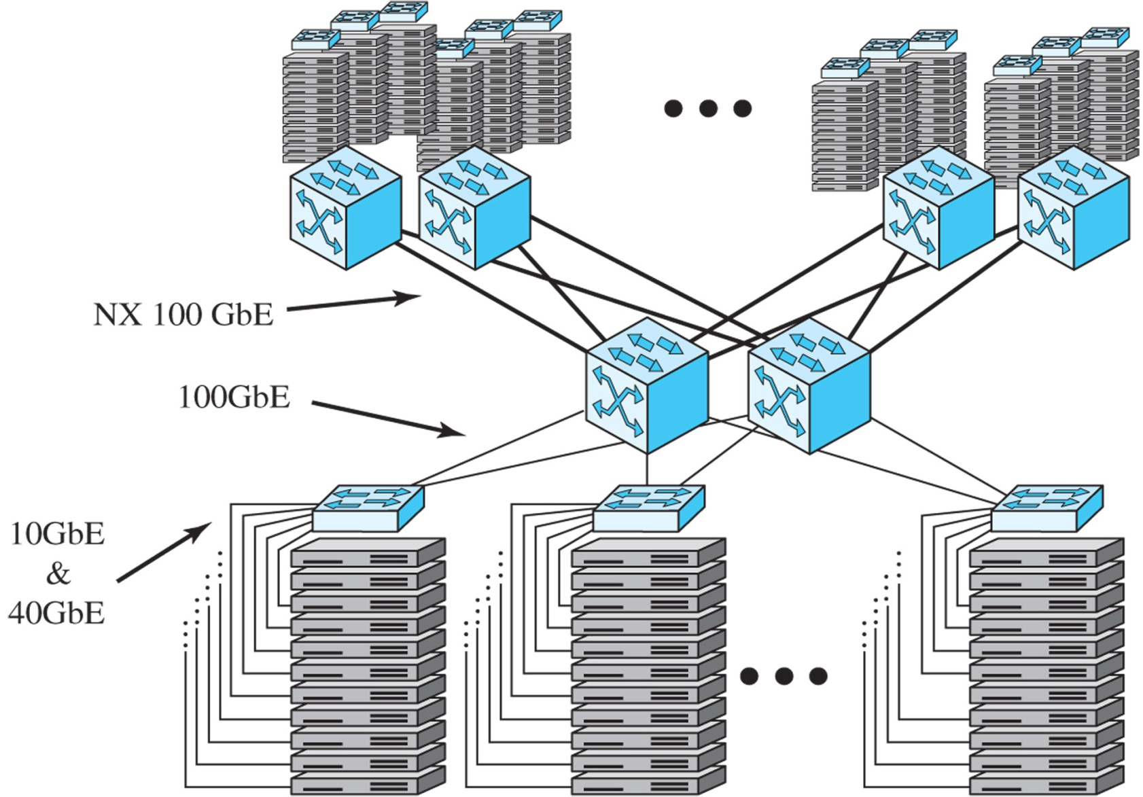
Example 100-Mbps Ethernet Configuration for Massive Blade Server Site

