Slide 1
Chapter 1
Introduction to Statistics

Slide 2
Chapter Outline
1.1 An Overview of Statistics
1.2 Data Classification
1.3 Experimental Design

Slide 3
Section 1.1
An Overview of Statistics

Slide 4
Section 1.1 Objectives
Define statistics
Distinguish between a population and a sample
Distinguish between a parameter and a statistic
Distinguish between descriptive statistics and inferential statistics

Slide 5
What is Data?
Data
Consist of information coming from observations, counts, measurements, or responses.
“People who eat three daily servings of whole grains have been shown to reduce their risk of…stroke by 37%.” (Source: Whole Grains Council)
“Seventy percent of the 1500 U.S. spinal cord injuries to minors result from vehicle accidents, and 68 percent were not wearing a seatbelt.” (Source: UPI)

Slide 6
What is Statistics?
Statistics
The science of collecting, organizing, analyzing, and interpreting data in order to make decisions.

Slide 7
Data Sets
Population
The collection of all outcomes, responses, measurements, or counts that are of interest.
Sample
A subset of the population.

Slide 8
Example: Identifying Data Sets
In a recent survey, 1708 adults in the United States were asked if they think global warming is a problem that requires immediate government action. Nine hundred thirty-nine of the adults said yes. Identify the population and the sample. Describe the data set. (Adapted from: Pew Research Center)

Slide 9
Solution: Identifying Data Sets
The population consists of the responses of all adults in the U.S.
The sample consists of the responses of the 1708 adults in the U.S. in the survey.
The sample is a subset of the responses of all adults in the U.S.
The data set consists of 939 yes’s and 769 no’s.
Responses of adults in the U.S. (population)
Responses of adults in survey (sample)

Slide 10
Parameter and Statistic
Parameter
A number that describes a population characteristic.
Average age of all people in the United States
Statistic
A number that describes a sample characteristic.
Average age of people from a sample of three states

Slide 11
Example: Distinguish Parameter and Statistic
Decide whether the numerical value describes a population parameter or a sample statistic.
A recent survey of a sample of MBAs reported that the average salary for an MBA is more than $82,000. (Source: The Wall Street Journal)
Solution:
Sample statistic (the average of $82,000 is based on a subset of the population)

Slide 12
Example: Distinguish Parameter and Statistic
Decide whether the numerical value describes a population parameter or a sample statistic.
Starting salaries for the 667 MBA graduates from the University of Chicago Graduate School of Business increased 8.5% from the previous year.
Solution:
Population parameter (the percent increase of 8.5% is based on all 667 graduates’ starting salaries)

Slide 13

Branches of Statistics
Descriptive Statistics Involves organizing, summarizing, and displaying data.
e.g. Tables, charts, averages
Inferential Statistics Involves using sample data to draw conclusions about a population.

Slide 14
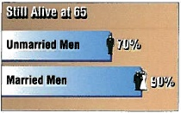
Example: Descriptive and Inferential Statistics
Decide which part of the study represents the descriptive branch of statistics. What conclusions might be drawn from the study using inferential statistics?
A large sample of men, aged 48, was studied for 18 years. For unmarried men, approximately 70% were alive at age 65. For married men, 90% were alive at age 65. (Source: The Journal of Family Issues)

Slide 15
Solution: Descriptive and Inferential Statistics
Descriptive statistics involves statements such as “For unmarried men, approximately 70% were alive at age 65” and “For married men, 90% were alive at 65.”
A possible inference drawn from the study is that being married is associated with a longer life for men.

Slide 16
Section 1.1 Summary
Defined statistics
Distinguished between a population and a sample
Distinguished between a parameter and a statistic
Distinguished between descriptive statistics and inferential statistics

Slide 17
Section 1.2
Data Classification

Slide 18
Section 1.2 Objectives
Distinguish between qualitative data and quantitative data
Classify data with respect to the four levels of measurement

Slide 19
Types of Data
Qualitative Data
Consists of attributes, labels, or nonnumerical entries.
Major
Place of birth
Eye color

Slide 20
Types of Data
Quantitative data
Numerical measurements or counts.
Age
Weight of a letter
Temperature

Slide 21
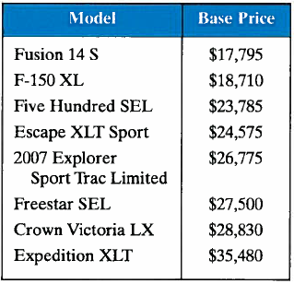
Example: Classifying Data by Type
The base prices of several vehicles are shown in the table. Which data are qualitative data and which are quantitative data? (Source Ford Motor Company)

Slide 22
Solution: Classifying Data by Type
Qualitative Data (Names of vehicle models are nonnumerical entries)
Quantitative Data (Base prices of vehicles models are numerical entries)

Slide 23
Levels of Measurement
Nominal level of measurement
Qualitative data only
Categorized using names, labels, or qualities
No mathematical computations can be made
Ordinal level of measurement
Qualitative or quantitative data
Data can be arranged in order
Differences between data entries is not meaningful

Slide 24
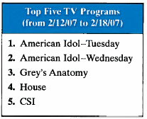
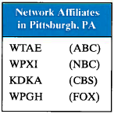
Example: Classifying Data by Level
Two data sets are shown. Which data set consists of data at the nominal level? Which data set consists of data at the ordinal level? (Source: Nielsen Media Research)

Slide 25
Solution: Classifying Data by Level
Ordinal level (lists the rank of five TV programs. Data can be ordered. Difference between ranks is not meaningful.)
Nominal level (lists the call letters of each network affiliate. Call letters are names of network affiliates.)

Slide 26
Levels of Measurement
Interval level of measurement
Quantitative data
Data can ordered
Differences between data entries is meaningful
Zero represents a position on a scale (not an inherent zero – zero does not imply “none”)

Slide 27
Levels of Measurement
Ratio level of measurement
Similar to interval level
Zero entry is an inherent zero (implies “none”)
A ratio of two data values can be formed
One data value can be expressed as a multiple of another

Slide 28
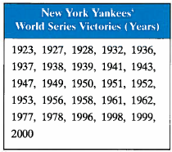
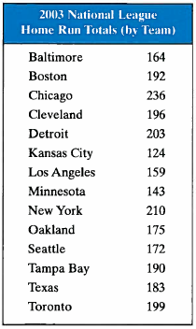
Example: Classifying Data by Level
Two data sets are shown. Which data set consists of data at the interval level? Which data set consists of data at the ratio level? (Source: Major League Baseball)

Slide 29
Solution: Classifying Data by Level
Interval level (Quantitative data. Can find a difference between two dates, but a ratio does not make sense.)
Ratio level (Can find differences and write ratios.)

Slide 30
Summary of Four Levels of Measurement
Level of Measurement | Put data in categories | Arrange data in order | Subtract data values | Determine if one data value is a multiple of another
Nominal | Yes | No | No | No
Ordinal | Yes | Yes | No | No
Interval | Yes | Yes | Yes | No
Ratio | Yes | Yes | Yes | Yes

Slide 31
Section 1.2 Summary
Distinguished between qualitative data and quantitative data
Classified data with respect to the four levels of measurement

Slide 32
Section 1.3
Experimental Design

Slide 33
Section 1.3 Objectives
Discuss how to design a statistical study
Discuss data collection techniques
Discuss how to design an experiment
Discuss sampling techniques

Slide 34
Designing a Statistical Study
Identify the variable(s) of interest (the focus) and the population of the study.
Develop a detailed plan for collecting data. If you use a sample, make sure the sample is representative of the population.
Collect the data.
Describe the data using descriptive statistics techniques.
Interpret the data and make decisions about the population using inferential statistics.
Identify any possible errors.

Slide 35
Data Collection
Observational study
A researcher observes and measures characteristics of interest of part of a population.
Researchers observed and recorded the mouthing behavior on nonfood objects of children up to three years old. (Source: Pediatric Magazine)

Slide 36
Data Collection
Experiment
A treatment is applied to part of a population and responses are observed.
An experiment was performed in which diabetics took cinnamon extract daily while a control group took none. After 40 days, the diabetics who had the cinnamon reduced their risk of heart disease while the control group experienced no change. (Source: Diabetes Care)

Slide 37
Data Collection
Simulation
Uses a mathematical or physical model to reproduce the conditions of a situation or process.
Often involves the use of computers.
Automobile manufacturers use simulations with dummies to study the effects of crashes on humans.

Slide 38
Data Collection
Survey
An investigation of one or more characteristics of a population.
Commonly done by interview, mail, or telephone.
A survey is conducted on a sample of female physicians to determine whether the primary reason for their career choice is financial stability.

Slide 39
Example: Methods of Data Collection
Consider the following statistical studies. Which method of data collection would you use to collect data for each study?
A study of the effect of changing flight patterns on the number of airplane accidents.
Solution:
Simulation (It is impractical to create this situation)

Slide 40
Example: Methods of Data Collection
A study of the effect of eating oatmeal on lowering blood pressure.
Solution:
Experiment (Measure the effect of a treatment – eating oatmeal)

Slide 41
Example: Methods of Data Collection
A study of how fourth grade students solve a puzzle.
Solution:
Observational study (observe and measure certain characteristics of part of a population)

Slide 42
Example: Methods of Data Collection
A study of U.S. residents’ approval rating of the U.S. president.
Solution:
Survey (Ask “Do you approve of the way the president is handling his job?”)

Slide 43
Key Elements of Experimental Design
Control
Randomization
Replication

Slide 44
Key Elements of Experimental Design: Control
Control for effects other than the one being measured.
Confounding variables
  Occurs when an experimenter cannot tell the difference between the effects of different factors on a variable.
  A coffee shop owner remodels her shop at the same time a nearby mall has its grand opening. If business at the coffee shop increases, it cannot be determined whether it is because of the remodeling or the new mall.

Slide 45
Key Elements of Experimental Design: Control
Placebo effect
  A subject reacts favorably to a placebo when in fact he or she has been given no medical treatment at all.
  Blinding is a technique where the subject does not know whether he or she is receiving a treatment or a placebo.
  Double-blind experiment neither the subject nor the experimenter knows if the subject is receiving a treatment or a placebo.

Slide 46
Key Elements of Experimental Design: Randomization
Randomization is a process of randomly assigning subjects to different treatment groups.
Completely randomized design
  Subjects are assigned to different treatment groups through random selection.
Randomized block design
  Divide subjects with similar characteristics into blocks, and then within each block, randomly assign subjects to treatment groups.

Slide 47
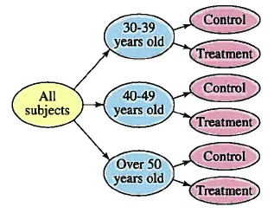
Key Elements of Experimental Design: Randomization
Randomized block design
An experimenter testing the effects of a new weight loss drink may first divide the subjects into age categories. Then within each age group, randomly assign subjects to either the treatment group or control group.

Slide 48
Key Elements of Experimental Design: Randomization
Matched Pairs Design
  Subjects are paired up according to a similarity. One subject in the pair is randomly selected to receive one treatment while the other subject receives a different treatment.

Slide 49
Key Elements of Experimental Design: Replication
Replication is the repetition of an experiment using a large group of subjects.
To test a vaccine against a strain of influenza, 10,000 people are given the vaccine and another 10,000 people are given a placebo. Because of the sample size, the effectiveness of the vaccine would most likely be observed.

Slide 50
Example: Experimental Design
A company wants to test the effectiveness of a new gum developed to help people quit smoking. Identify a potential problem with the given experimental design and suggest a way to improve it.
The company identifies one thousand adults who are heavy smokers. The subjects are divided into blocks according to gender. After two months, the female group has a significant number of subjects who have quit smoking.

Slide 51
Solution: Experimental Design
Problem:
The groups are not similar. The new gum may have a greater effect on women than men, or vice versa.
Correction:
The subjects can be divided into blocks according to gender, but then within each block, they must be randomly assigned to be in the treatment group or the control group.

Slide 52
Sampling Techniques
Simple Random Sample
Every possible sample of the same size has the same chance of being selected.
x
x
x
x
x
x
x
x
x
x
x
x
x
x
x
x
x
x
x
x
x
x
x
x
x
x
x
x
x
x
x
x
x
x
x
x
x
x
x
x
x
x
x
x
x
x
x
x
x
x
x
x
x
x
x
x
x
x
x
x
x
x
x
x
x
x
x
x
x
x
x
x
x
x
x
x
x
x
x
x
x
x
x
x
x
x
x
x
x
x
x
x
x
x
x
x
x
x
x
x
x
x
x
x
x
x
x
x
x

Slide 53
Simple Random Sample
Random numbers can be generated by a random number table, a software program or a calculator.
Assign a number to each member of the population.
Members of the population that correspond to these numbers become members of the sample.

Slide 54
Example: Simple Random Sample
There are 731 students currently enrolled in statistics at your school. You wish to form a sample of eight students to answer some survey questions. Select the students who will belong to the simple random sample.
Assign numbers 1 to 731 to each student taking statistics.
On the table of random numbers, choose a starting place at random (suppose you start in the third row, second column.)

Slide 55
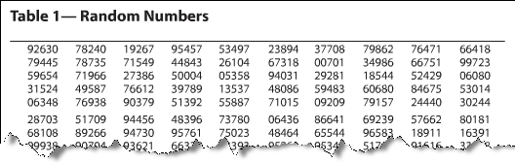
Solution: Simple Random Sample
Read the digits in groups of three
Ignore numbers greater than 731
The students assigned numbers 719, 662, 650, 4, 53, 589, 403, and 129 would make up the sample.

Slide 56

Other Sampling Techniques
Stratified Sample
Divide a population into groups (strata) and select a random sample from each group.
To collect a stratified sample of the number of people who live in West Ridge County households, you could divide the households into socioeconomic levels and then randomly select households from each level.

Slide 57
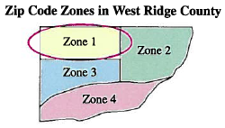
Other Sampling Techniques
Cluster Sample
Divide the population into groups (clusters) and select all of the members in one or more, but not all, of the clusters.
In the West Ridge County example you could divide the households into clusters according to zip codes, then select all the households in one or more, but not all, zip codes.

Slide 58
Other Sampling Techniques
Systematic Sample
Choose a starting value at random. Then choose every k^{th} member of the population.
In the West Ridge County example you could assign a different number to each household, randomly choose a starting number, then select every 100th household.

Slide 59
Example: Identifying Sampling Techniques
You are doing a study to determine the opinion of students at your school regarding stem cell research. Identify the sampling technique used.
You divide the student population with respect to majors and randomly select and question some students in each major.
Solution:
Stratified sampling (the students are divided into strata (majors) and a sample is selected from each major)

Slide 60
Example: Identifying Sampling Techniques
You assign each student a number and generate random numbers. You then question each student whose number is randomly selected.
Solution:
Simple random sample (each sample of the same size has an equal chance of being selected and each student has an equal chance of being selected.)

Slide 61
Section 1.3 Summary
Discussed how to design a statistical study
Discussed data collection techniques
Discussed how to design an experiment
Discussed sampling techniques

